Slide 1


Nanoparticles specific for Slan+ monocytes as potential therapeutic tools in systemic lupus erythematosus.
Karen Álvarez¹, Paula Losada¹, Ricardo Pineda², Luis Fernando Giraldo³, Esneyder Ruiz Agudelo³, Gloria Vásquez^{1,4} and Mauricio Rojas^{1, 5}
¹ Grupo de Inmunología Celular e Inmunogenética, Facultad de Medicina, Universidad de Antioquia, Medellín, Colombia
. ² ARTMEDICA IPS, Medellín, Colombia
³Laboratorio de Investigación en Polimeros
⁴ Sección de Reumatología, Hospital Universitario San Vicente Fundación, Medellín, Colombia
. ⁵ Unidad de citometría de flujo, Universidad de Antioquia, Medellín, Colombia
Notes:
1. Good afternoon, it is a pleasure to be here. My name is Karen, I am a Phd student at University of Antioquia and grupo de inmunología celular e inmunogenética from medellin, Colombia. Today, i am going to talk to you about this Project called: Nanoparticles specific for Slan+ monocytes as potential therapeutic (ˌθɛrəˈpjuːtɪk/therapiuric) tools in lupus

Slide 2
Conflict of interest
Nothing to Disclose

Slide 3
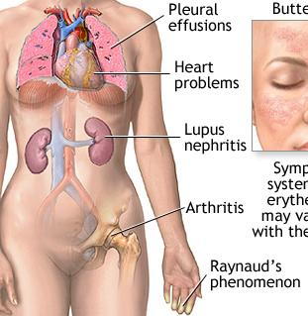
Systemic lupus erythematosus (SLE)
Progressive systemic inflammatory disease resulting in major organ system failure.
Lupus patients have alterations in innate and adaptive immune cells, including MONOCYTES.
Interior
Notes:
Lupus is chronic autoimmune disorder that present a broad spectrum of clinical manifestations, like blood disorder, renal involment, arthritis and others.
Lupus patients have alterations in innate and adaptive immune cells, including MONOCYTES.
SLE affects almost every organ and presents with a high range of clinical manifestations (5). The damage to
various organs can be explained by a disturbance of innate and adaptive immune responses leading
to a production of autoantibodies, immune complexes, and a loss of immune tolerance to
autoantigens

Slide 4
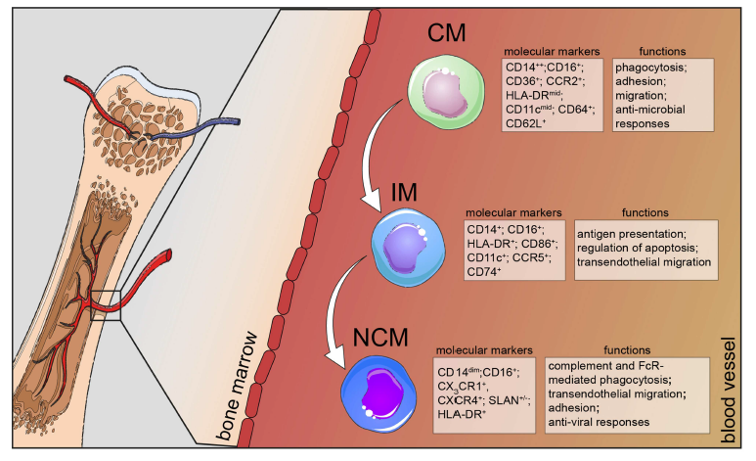
Monocytes and lupus
Monocytes play a significant role in the pathogenesis of SLE
The proportion and numbers of monocyte subsets are altered in lupus patients.
Notes:
Different studies have demonstrated that Monocytes play an important rol in the development of Lupus. In fact, Monocytes from lupus patients have different phenotypic and functional alterations in comparison with healthy controls.
Three subpopulations of monocytes have been described: classical, intermediate and nonclassical monocytes. Our group and others research groups had demonstrated previously lupus patients have alterations in The proportion and numbers of CIRCULATING monocyte subpopulations.
Monocytes play a significant role in the pathogenesis of SLE

Slide 5
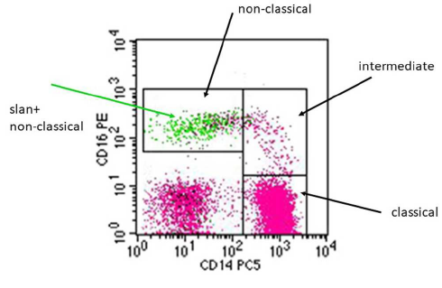
Slan+ Monocytes
6-sulfo LacNAc+ (slan) monocytes (slanMo) are a subset of nonclassical monocytes, which have been considered as one of the principal pro-inflammatory cells in different diseases, including the autoimmune ones, such as systemic lupus erythematosus (SLE).
Hofer et al. Blood. 2015
Notes:
Recently, a newer monocyte subpopulation have been described: slan Monocytes.
These cells are a subset of nonclassical monocytes, these cells are one of the important pro-inflammatory cells in different diseases, including lupus.

Slide 6
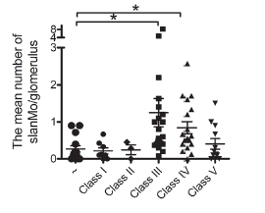
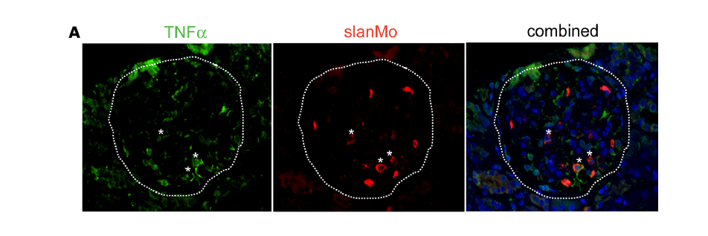
Slan Monocytes and SLE
Slan Monocytes and SLE
Slan+ Monocytes were increased within glomeruli of human lupus nephritis samples, which locally expressed TNF-α.
Oralu et al. JCI Insight. 2018
Notes:
PREVIOUS studies have demonstrated that Slan+ Monocytes were increased within glomerulus of human lupus nephritis samples, and these cells produce locally TNF-α. Suggesting that these cells play a very important rol in the immunopathogenesis of LUPUS, for these reasons these cells could be a therapeutic target in lupus.
For these reasons these cells are attractive therapeutic targets

Slide 7
Jak-Stat pathway and SLE
Increased levels of total STAT1 protein and its activated/phosphorylated form were detected in kidney samples from MRL/lpr mice with LN as compared to those from control mice (Dong et al. Lupus. 2007)
Lupus patients have polymophims in JAK2, TYK2 y STAT4 (Bolin et al. Plos one. 2013)
The mRNA expression level of SOCS1 was significantly decreased in SLE patients in comparison with healthy controls (Qiu et al. Clin Exp Med. 2015)
Jak inhibitors (Jakinibs) could be used in the treatment of SLE. However, the use of these Jakinibs have been associated with different side effects.
Notes:
In lupus patients there are alteration in different immune pathways, like jak.-stat pathway. Previous studies suggest that this pathway is over activated in lupus patients and mice model of LES. For example:
Mice models of lupus have increased levels of phospho stat-1 In comparision with control mice (Dong et al. Lupus. 2007)
By other way. Lupus patients have polymophims in JAK2, TYK2 y STAT4 (Bolin et al. Plos one. 2013)
And lupus patients present decrease in SOCs1, the negative regulator of JAK STAT pathway(Qiu et al. Clin Exp Med. 2015)
These evidences suggest that this pathway may play an important role in the pathogenesis of sle. So the jak inhibitors could be use in the treatment of sle. However , the use of these Jakinibs have been associated with differents side effects.
Increased levels of total STAT1 protein and its activated/phosphorylated form were detected in kidney samples from MRL/lpr mice with LN as compared to those from control mice. Phosphorylated STAT1 was predominantly detected in glomeruli cells. Gene expression of the STAT induced feedback inhibitors suppressor of cytokine signalling-1 (SOCS-1) and SOCS-3 was also enhanced in MRL/lpr mice. In MRL/lpr mesangial cells, both IFN-alpha and IFN-gamma rapidly induced the phosphorylation of STAT in vitro. Our results demonstrate that expression and activation of STAT1 are significantly increased in murine lupus nephritis, and indicate that STAT1 signalling pathway may play an important role in the pathogenesis of kidney inflammation.

Slide 8
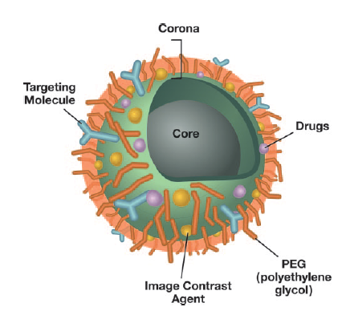
Nanoparticles
Jakinibs encapsulated PLGA nanoparticles to modulate the pro-inflamatory function of slan + monocytes
Mcneil et al. Journal of Leukocyte Biology.2005
Notes:
For that reason, in order to reduce the side effects of Jakinibs we propose to design Jak inhibitors encapsulated PLGA nanoparticles to modulate the pro-inflamatory function of slan monocytes without affect other immune cells.

Slide 9
Objetive
Evaluate the capacity of Itacitinib encapsulated nanoparticles functionalized with lectins able to bind slan to inhibit the JAK-STAT pathway in circulating monocyte subpopulations, specially SlanMo from SLE patients.
Notes:
Based on these considerations we proposed to evaluate the capacity of Itacitinib encapsulated nanoparticles functionalized with lectins able to bind slan to inhibit the JAK-STAT pathway in circulating monocyte subpopulations, specially SlanMo from SLE patients.
and no specific drug has been found to treat this condition effectively.

Slide 10
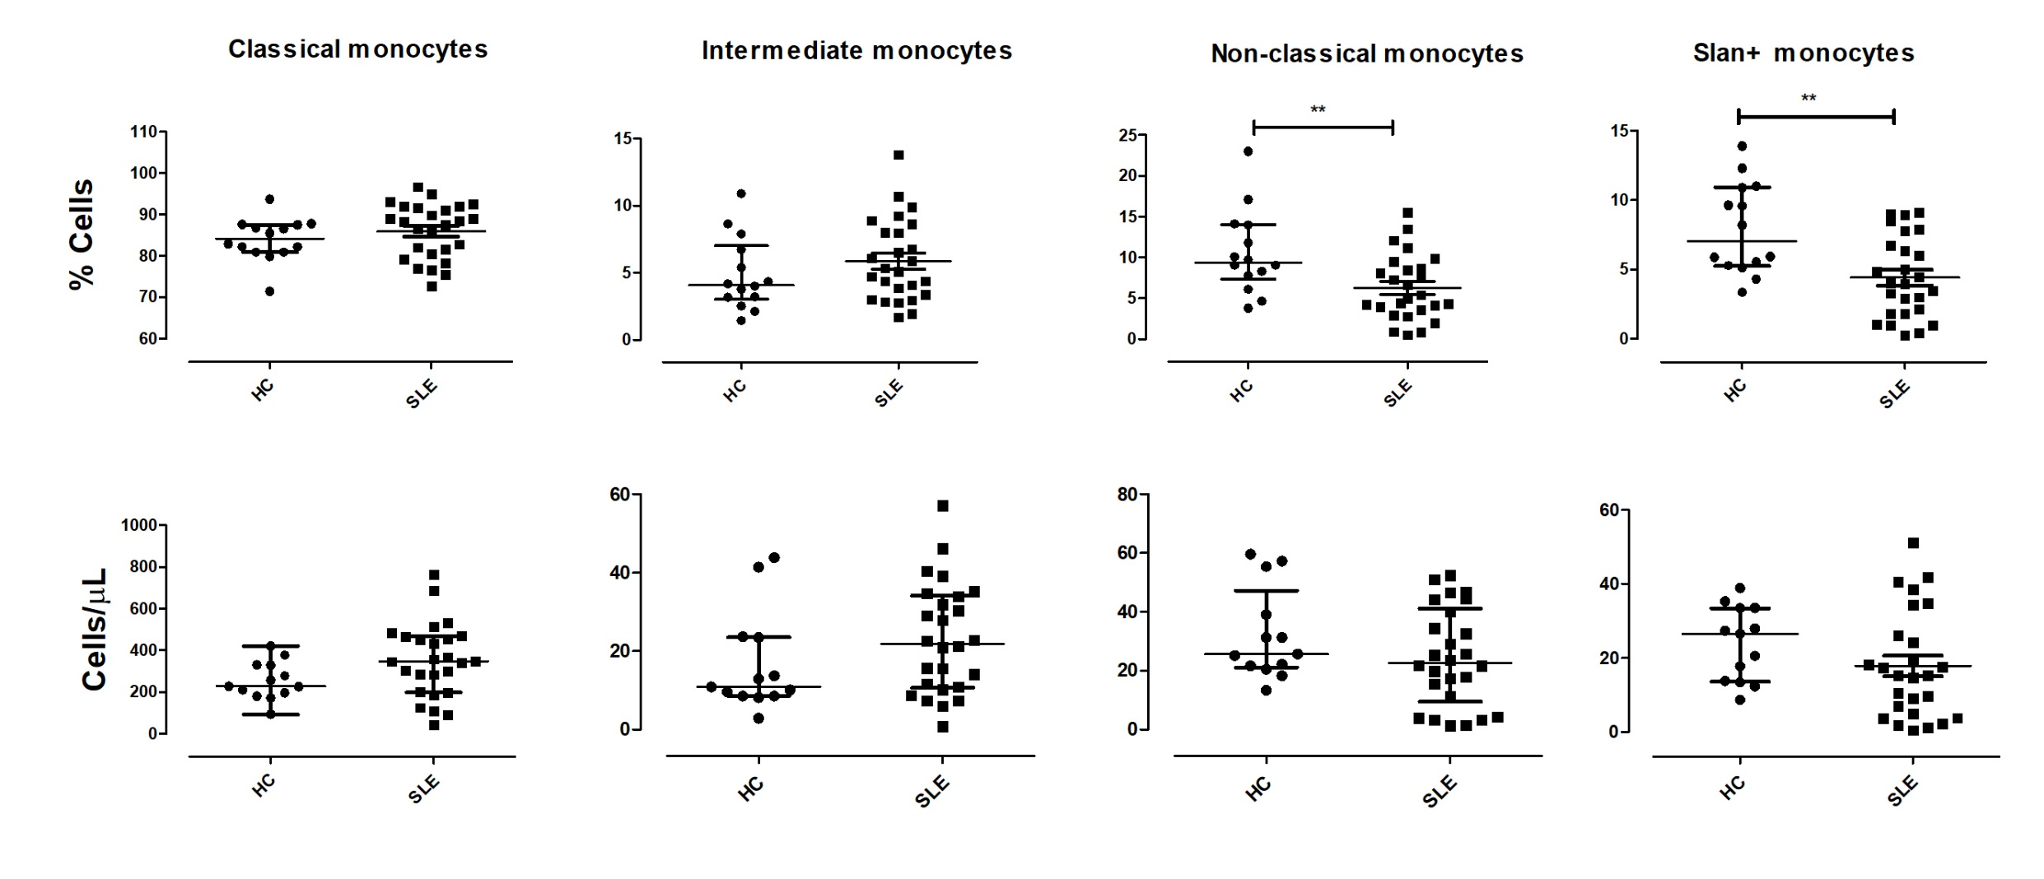
Results
SLE patients had a decrease in the proportion of circulating non-classical and Slan monocytes compared with healthy controls
Notes:
First, we evaluated circulating Monocyte subpopulations in SLE patients (n=23) and healthy controls (n=13) by flow cytometry. As we can see here, we found that SLE patients had a decrease in the proportion of circulating non-classical and Slan monocytes compared with healthy controls, this reduction could be explained by the recruitment of these cells to sites of inflammation.

Slide 11
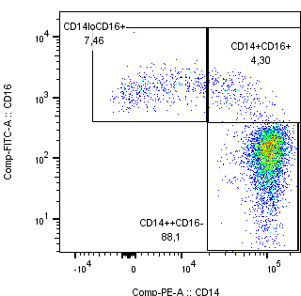
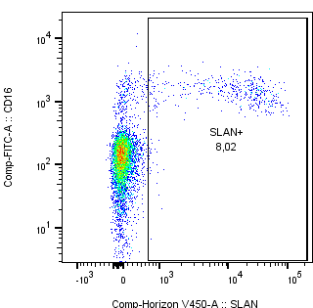
A
B
SUBPOBLACIONES DE MONOCITOS.
MONOCITOS SLAN+
Trabajo conjunto con Paula Losada (Estudiante Doctorado CCBB)
Notes:
SUPBLACIONES DE MONOCITOS EN UN INDIVIDUO SANO= LUZ VIVIANA MUNERA
Figura 1. Diagrama de puntos representativo de la estrategia de análisis utilizada para seleccionar las subpoblaciones de monocitos no clásicos (CD14loCD16+), intermedios (CD14+CD16+) clásicos (CD14++CD16-) (A) y monocitos slan+ (B), definidos inicialmente como células CD14+ HLA-DR+.

Slide 12
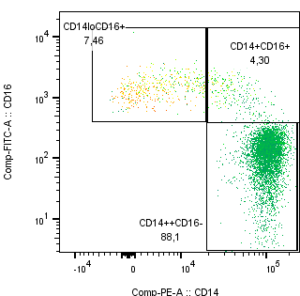
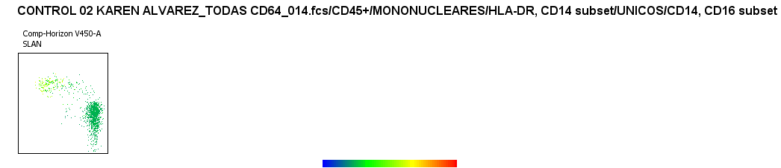
La mayoría de los monocitos Slan+ son monocitos no clásicos. Mapa de calor que representa la expresión del marcador SLAN en las diferentes subpoblaciones de monocitos: no clásicos (CD14loCD16+), intermedios (CD14+CD16+) y clásicos (CD14++CD16-), definidos inicialmente como células CD14+ HLA-DR+.
Trabajo conjunto con Paula Losada (Estudiante Doctorado CCBB)
Notes:
SUPBLACIONES DE MONOCITOS EN UN INDIVIDUO SANO= LUZ VIVIANA MUNERA
Figura 2. La mayoría de los monocitos Slan+ son monocitos no clásicos. Mapa de calor que representa la expresión del marcador SLAN en las diferentes subpoblaciones de monocitos: no clásicos (CD14loCD16+), intermedios (CD14+CD16+) y clásicos (CD14++CD16-), definidos inicialmente como células CD14+ HLA-DR+.
Control Luz Viviana Munera

Slide 13
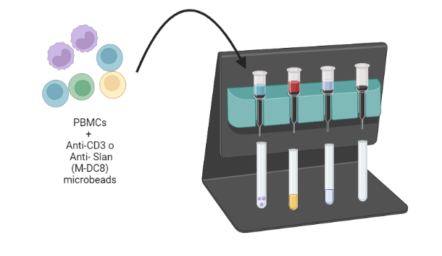
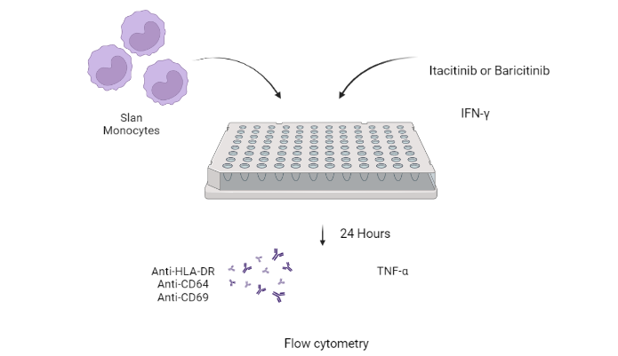
Isolation and stimulation of SlanMo
Slan (M-DC8) ⁺ Monocyte Isolation Kit, human
Notes:
Then, we wanted to know if Jakinibs could modulate the inflammatory function of slan monocytes. We isolated SlanMo from peripheral blood samples from healthy controls using a commercial Slan (M-DC8)+ Monocyte Isolation Kit. We treated slanmo with 2 Janus quinases inhibitors: Itacitinib or baricinib for 1 hour, then monocytes were treated with IFN-gamma, after 24 hours we evaluated Membrane markers (HLA-DR, CD64 and CD69) expression and TNF-α production by flow cytometry

Slide 14
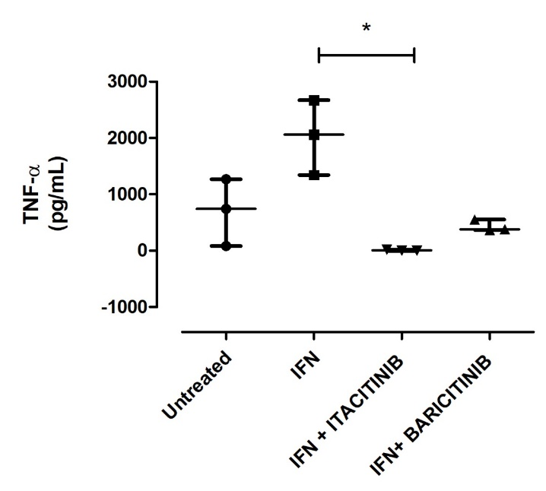
IFN-γ increased the expression of surface molecules HLA-DR, CD64 and CD69 and TNF-α accumulation. Baricitinib and Itacitinib antagonized the effects of IFN-γ.
Notes:
As we can see here, the treatment of SlanMo with IFN induce an increase in the expression of surface molecules HLA-DR, CD64 and CD69 on SlanMo and TNF-α accumulation . We also found that Baricitinib and Itacitinib inhibit the effect of IFN on monocytes.
Suggesting that these inhibitors could modulate de pro-inflammatory functions of theses cells

Slide 15
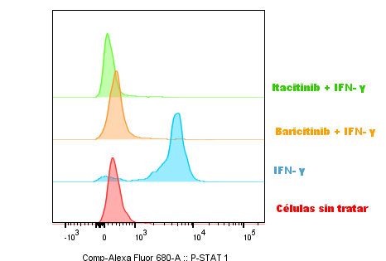
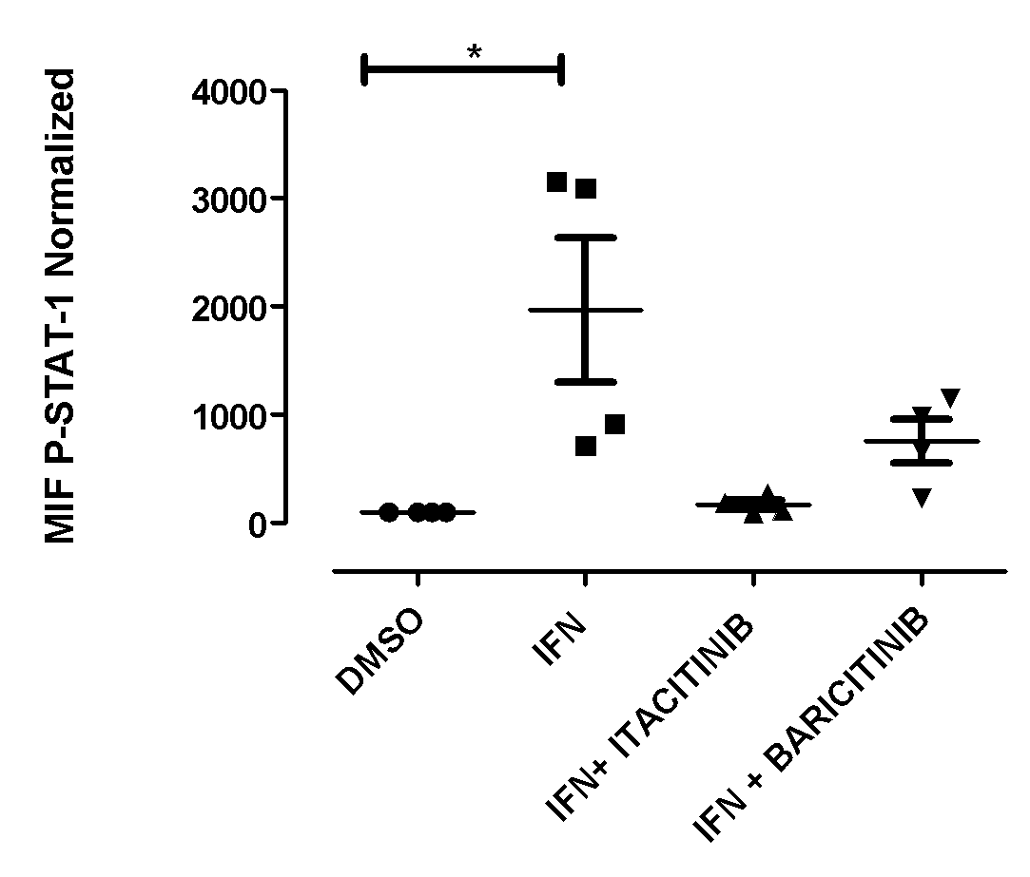
A
B
IFN increased the production of TNF by SlanMo. Baricitinib and Itacitinib antagonized the effects of IFN.
n= 4 (independet experiments)
Kruskall-wallis
Notes:
These results suggests that Jakinibs modulate the pro-inflammatory function of slan monocytes. For that reason, we wanted to design an Itacitinib encapsulated nanoparticle to target the SlanMo, without affect other immune cells.

Slide 16
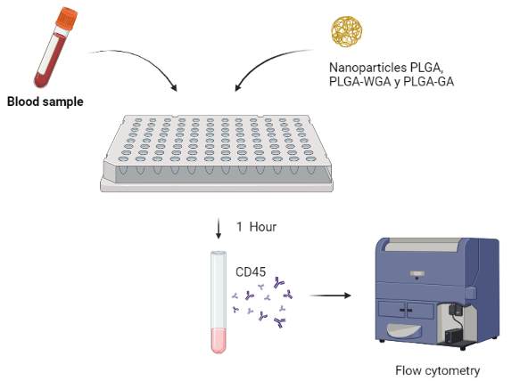
Notes:
For these reasons, we are trying to desing Nanoparticles specific for Slan+ monocytes and encapsulated jak inhibitors in these nanoparticles in order to modulate the inflammatory function of these cells without affect other immune cells.
we evaluated the union/internalization of fluorescent nanoparticles functionalized with the lectin WGA or galactosamine by leukocytes.

Slide 17
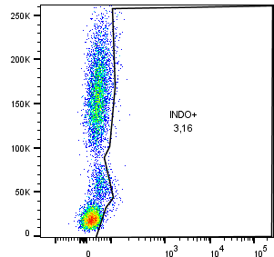
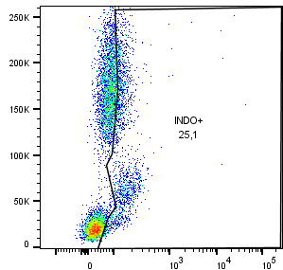
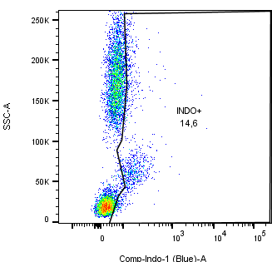
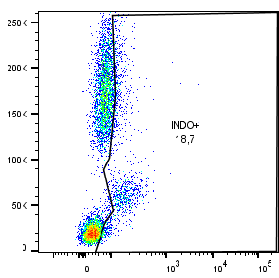
SIN NP
PLGA
PLGA/WGA
PLGA/GA
SSC-A
Fluorescense 530 nm (curcumina)
PLGA-WGA nanoparticles were mainly bound and internalized by monocytes compared with other populations of leukocytes suggesting the potential role of these nanoparticles to target monocytes and possibly more specifically SlanMo for the treatment of SLE.
Notes:
as we can see here, PLGA-WGA nanoparticles were uptake efficiently by monocytes compared with other populations of leukocytes suggesting the potential role of these nanoparticles to target monocytes and possibly more specifically SlanMo for the treatment of SLE.

Slide 18
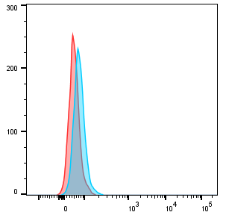
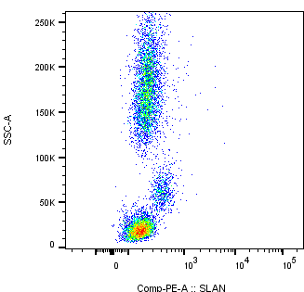
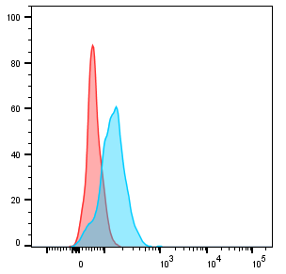
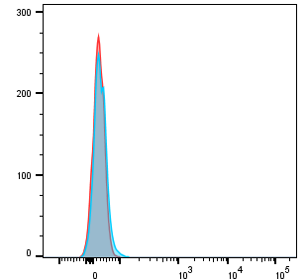
A
Granulocytes
0 μL de NP PLGA-WGA
30 μL de NP PLGA-WGA
Monocytes
PLGA-WGA nanoparticles were uptook efficiently by monocytes compared with other populations of leukocytes
Lymphocytes
Fluorescence en 530 nm (curcumina)
Notes:
we established that PLGA-WGA nanoparticles were uptook efficiently by monocytes compared with other populations of leukocytes suggesting the potential role of these nanoparticles to target monocytes and possibly more specifically SlanMo for the treatment of SLE.

Slide 19
Conclusions
SLE patients had a decrease in the proportion of circulating non-classical and SlanMo compared with healthy controls, it could be explained by the recruitment of these cells to sites of inflammation.
Until now, we established that PLGA-WGA were mainly bound and internalized by monocytes compared with other populations of leukocytes suggesting the potential role of these nanoparticles to target monocytes and possibly more specifically SlanMo for the treatment of SLE. In the future, we will design an Itacitinib encapsulated nanoparticle to target the SlanMo

