Slide 1
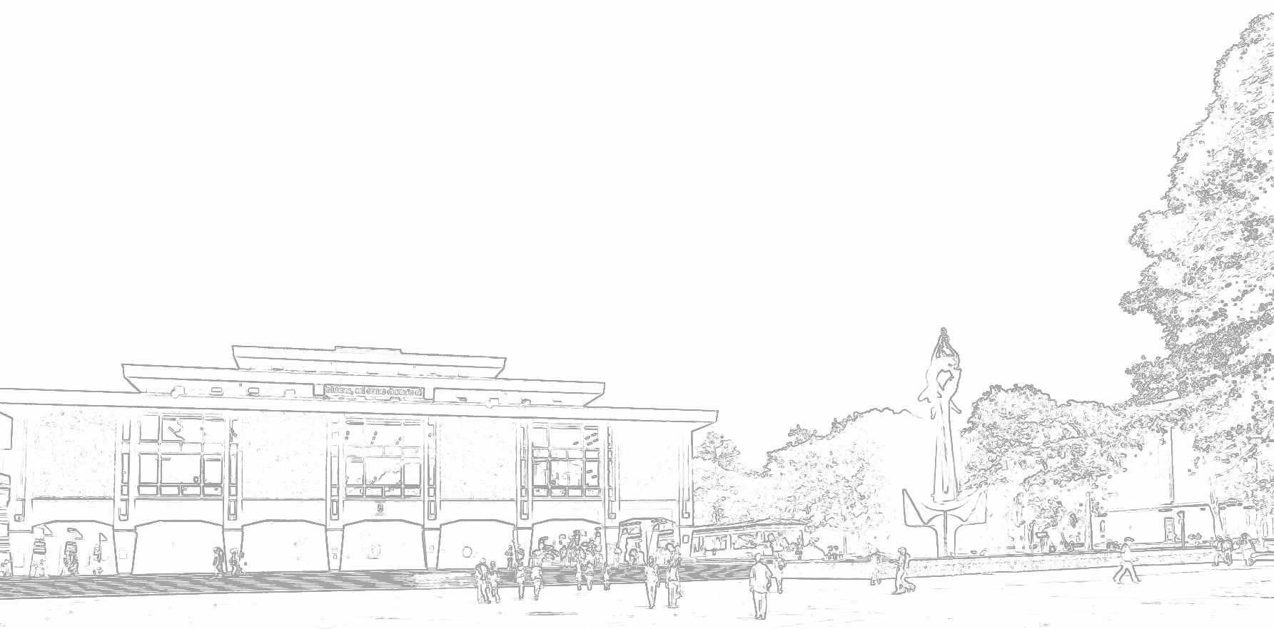
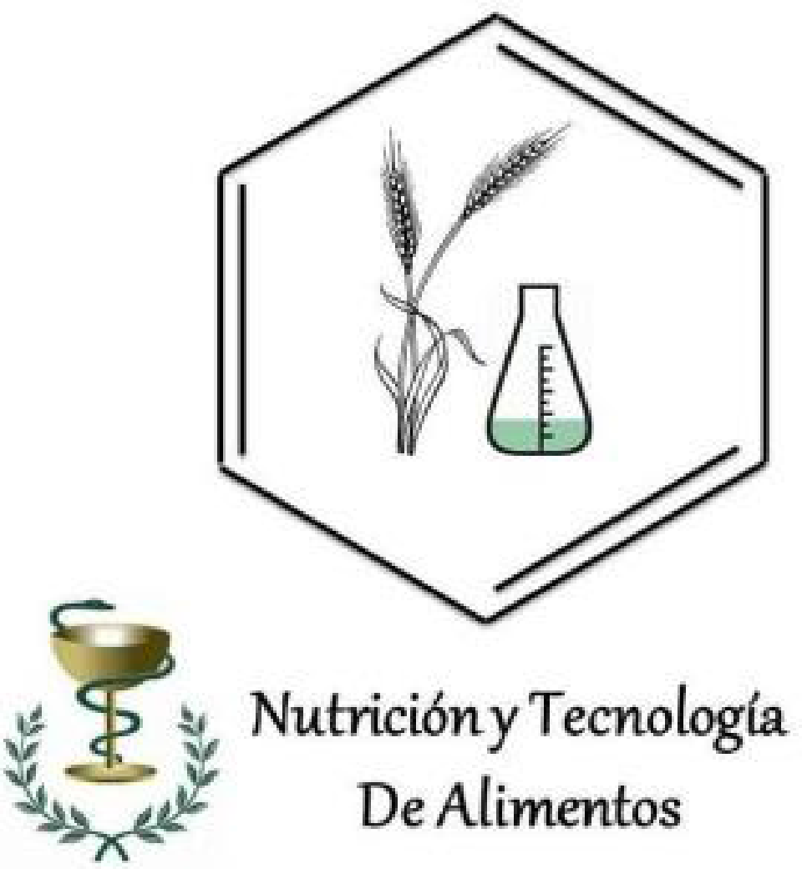
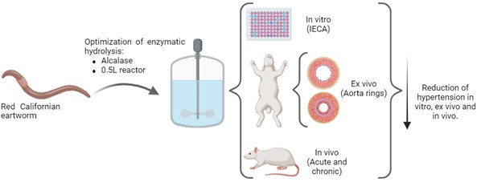
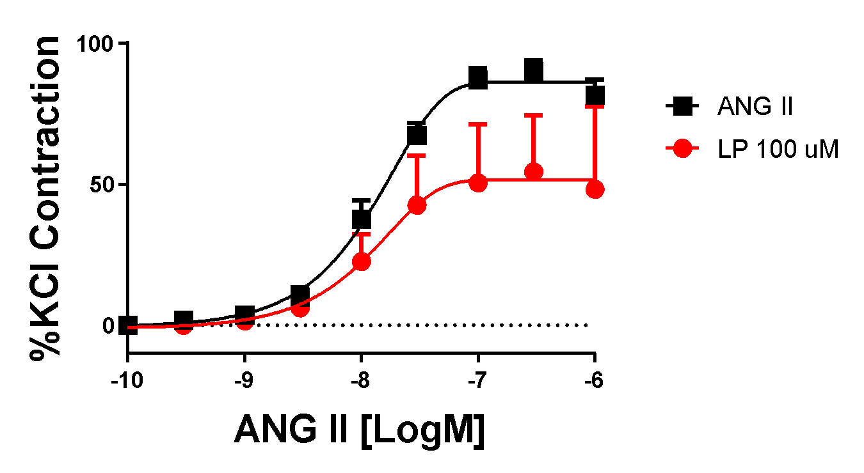
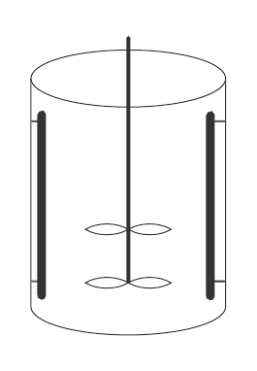
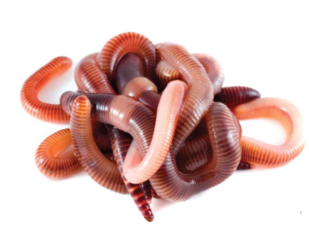
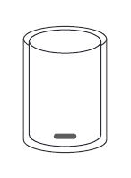
Evaluation of the potential use of the enzymatic hydrolysate of Californian red worm on blood pressure reduction by in vitro, ex vivo and in vivo studies.
Gaviria Gaviria, Yhoan¹, Zapata Montoya, José Edgar¹
1-Universidad de Antioquia, Nutrition and food technology research group, Medellín, Colombia
Corresponding author: edgar.zapata@udea.edu.co
Graphycal Abstract
Figure 2. Angiotensin II-converting enzyme inhibition of Californian redworm hydrolysates as a function of concentration.
Introduction
Table 1. Sensitivity (pD2) and maximal responses (Emax) to L-Name with and without endothelium and to angiotensin-II in aortic rings.
The California red earthworm (Eisenia Fetida) plays an important role in the decomposition of garbage and organic waste. However, although they have been used for thousands of years for their therapeutic benefits, the scientific evidence for the use of bioactive compounds has not been well proven in practice. The objective of this study was evaluated the In vitro, Ex vivo, and In vivo antihypertensive activity of E. fetida protein hydrolysates.
Dilatation
Agonist | pD₂ | p | %Emax | p
LP | 4.48 ± 0.08 | 0.04 | 28.45 ± 8 | 0.018
LP + without endothelium | 5.7 ± 0.1 |  | 9.408 ± 3.2
LP + L-name | 5.78 ± 0.18 |  | 3.924 ± 5.3
Contraction
Agonist | pD₂ | p | %Emax | p
Angiotensin 2 | 7.82 ± 0.03 | 0.05 | 89.86 ± 5.2 | 0.008
Angiotensin 2 + LP | 7.84 ± 0.07 |  | 54.38 ± 21.8
Methodology
The worms were manually separated, washed with water, purged for 4 hours with 4% sodium bicarbonate, then sacrificed using saline solution. The in vitro antihypertensive capacity was performed by measuring angiotensin-converting enzyme inhibition (ACEI). For the ex vivo assays, rabbit aorta was used to measure relaxation; blocking effect of E. fetida peptides (LP) on contractile agonists. Intact rings were preincubated with LP at a single concentration of 100 μM for 20 min. Relaxation studies were performed after inducing contraction with 1 µM PE. For the in vivo assay, we used 8-week-old Wistar rats weighing between 250 and 300 g (n=5 per treatment). rats with induced hypertension were used to perform acute (hypotension) and chronic assays, using captopril as a control in all assays.
All the values are expressed as mean ± SEM (n=5). Emax, maximal effect expressed as a percentage of the response induced; pD2 -log one-half Emax. P<0.05, Student’s t-test
Optimization of enzymatic hydrolysis – 0.5 L
FIGURE 3. Vasodilator analysis in isolated organ (aortic rings) of rabbit
Alcalase®
Enzymatic hydrolysis scale-up – 7.5 L
Antihypertensive:
- In vitro
- Ex vivo
- In vivo
FIGURE 1 methodology diagram
Results and discussion
FIGURE 4. Evaluation of antihypertensive activity on rats with induced hypertension
Figure 1 show as ACEI percentage increases as the hydrolysate concentration increases, yielding a IC₅₀ of 358 ppm (0.358 mg/mL). In figure 2 is observed as maximum relaxation percentage of 38% was achieved in the hydrolysate sample with endothelium (LP). Conversely, when the endothelium was removed, the relaxation percentage was much lower (approximately 5%), with no statistically significant differences with L-NAME at specific points. This indicates that the vasorelaxation of E. fetida hydrolysate peptides is endothelium-dependent. Aquí voy: octubre
With respect to the In vivo assays, the hypotensive test showed that the hydrolysate can reduce blood pressure by up to 32% in only 2 hours, while the chronic analysis showed that the hydrolysate at 150ppm did not present statistically significant differences with the control (captopril) during the 15 days of analysis.
Conclusion
The Red Californian earthworm hydrolysate presents bioactive compounds identified with antihypertensive activities in vitro, ex vivo and in vivo in different isolated and animal models. The study demonstrates the efficacy of the hydrolysate to be used as an alternative in the treatment and prevention of hypertension, and it can be implemented in functional foods or nutraceutical foods.
Acknowledgments
References
Universidad de Antioquia. MINCIENCIAS through the convening for strengthening knowledge on institutions of public superiority education. (Project Code 82040),
Gaviria, et. al (2023).
Cupitra, et. al (2021)

