Slide 1
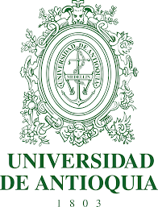
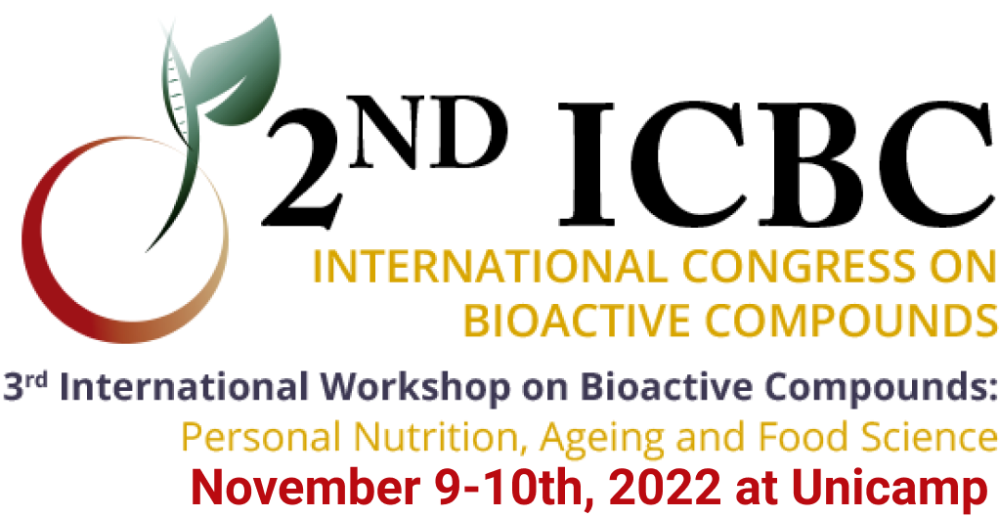
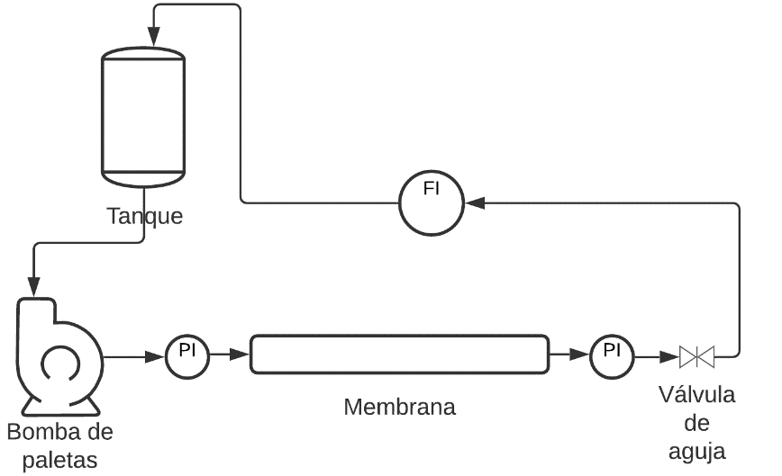
Diapositiva de instrucciones
OBTAINING ANTIOXIDANT AND IRON CHELATORS PEPTIDES BY ENZYMATIC HYDROLYSIS OF RED CALIFORNIAN EARTHWORM.
GAVIRIA, Y.1, ZAPATA, J. E.1*
edgar.zapata@udea.edu.co
1 Nutrition and Food Technology Group, Universidad de Antioquia, Cl. 67 #53-108, Medellín, Antioquia.
INTRODUCTION
Californian Red Worm (Eisenia foetida) plays an important role in the decomposition of garbage and organic wastes. However, although they have been used for thousands of years for their therapeutic benefits, the scientific evidence for the use of its bioactive compounds has not been well tested in practice.
OBJETIVE
The objective of this study was optimized enzymatic hydrolysis of California red worm (Eisenia foetida) to obtain enzymatic hydrolysates with biological activities and its fractions, using crossflow membrane filtration system.
MATERIALS AND METHODS
FIGURE 2. Permeate flux behavior as a function of time and pore size in tangential filtration of hydrolysates.
The worms were manually separated, were washed with water, were purged for 4 hours with 4% sodium bicarbonate, and sacrificed with 7% saline solution, and finally, they were washed with drinking water. To hydrolysis process a 0.5 L reactor was used. To the hydrolysis optimization, a spherical composite central response surface design with five points in the center was used using 4 factors, pH (7-9), temperature (40-60 °C), substrate (100-200 g) and enzyme (500-1500 uL), with response variables, percentage of soluble protein (PP), degree of hydrolysis (DH) and antioxidant capacity (AC) ABTS and FRAP. Fractionation was performed with 7-channel membranes of 0.013 m² area and 250 mm length (Tami inc., France) with cut-off molecular weights of 3 and 1 kDa, using transmembrane pressure of 4 bar and retentate flow rate of 450 L/h at 20°C and pH 8.5 (see fig. 1).
FIGURE 3. Antioxidant activity TEAC and ORAC
FIGURE 1. Tangecial ultrafiltration system
RESULT
The optimal hydrolysis conditions were pH 8.5, temperature 45°C, with 125.01 g substrate and 1243 uL of an enzyme, obtaining DH of 16.52%, PP of 3.38%, and AC of 2055 and 170 umol-equlox/g protein for ABTS and FRAP, respectively. In addition, the optimal hydrolysate has an ORAC oxygen radical scavenging activity of 823 umol-equ trolox/g protein and iron chelation with IC₅₀ at 150 ppm. The optimum hydrolysates was fractioned by membrane system. The complete hydrolyzate and the fractions obtained were analyzed to determine the biological antioxidant and iron-chelating (IC) activities. Membrane filtration concentrated the without hydrolysate proteins from feed fluid in retentate, while the concentration of permeate was significantly lower concerning to feed fluid, both in the 3 and 1 KDa membrane. The permeate flux to 1kDa membrane showed decreasing through of time, wile to 3kDa membrane stayed stable (see fig. 2). The ABTS and IC activities in permeate concerning the retained one are significantly higher for both membranes (see fig. 3 and 4).
FIGURE 4. Iron chelation activities
CONCLUSION
It is concluded that the enzymatic hydrolysate of California red worm has high AC and low IC50 in iron chelation, which makes it a substrate of interest for application in different industries.
ACKNOWLEDGEMENTS
MINCIENCIAS through the convening for strengthening knowledge on institutions of public superiority education (Project Code 82040).
REFERENCE
Adler-Nissen, J., Enzymic hydrolysis of food protein. Elsevier Applied Science Publishers, 116-124 (1985)
Daroit, D. J., y Brandelli, A., In vivo bioactivities of food protein-derived peptides – a current review, https://doi.org/10.1016/j.cofs.2021.01.002, Curr. Opin. Food Sci., 39, 120–129. (2021)
Heller, M. C., y Keoleian, G. A., Greenhouse Gas Emission Estimates of U.S. Dietary Choices and Food Loss, https://doi.org/10.1111/jiec.12174, J. Ind. Ecol., 19(3), 391–401 (2015)
Rodrigues, M., Carlesso, W. M., y otros ocho autores, Enzymatic hydrolysis of the Eisenia andrei earthworm: Characterization and evaluation of its properties, https://doi.org/10.1080/10242422.2017.1278754, Biocatal. Biotransformation, 35(2), 110–119. (2017)
Wang, Z., Ma, J., y otros cuatro autores, Membrane cleaning in membrane bioreactors: A review. https://doi.org/10.1016/j.memsci.2014.05.060, J. Membr. Sci., 468, 276–307. (2014)

