Slide 1

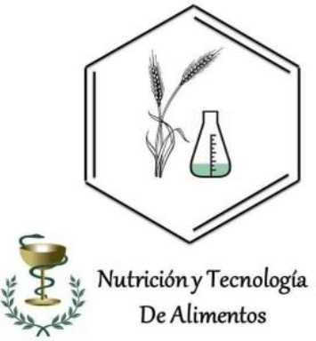



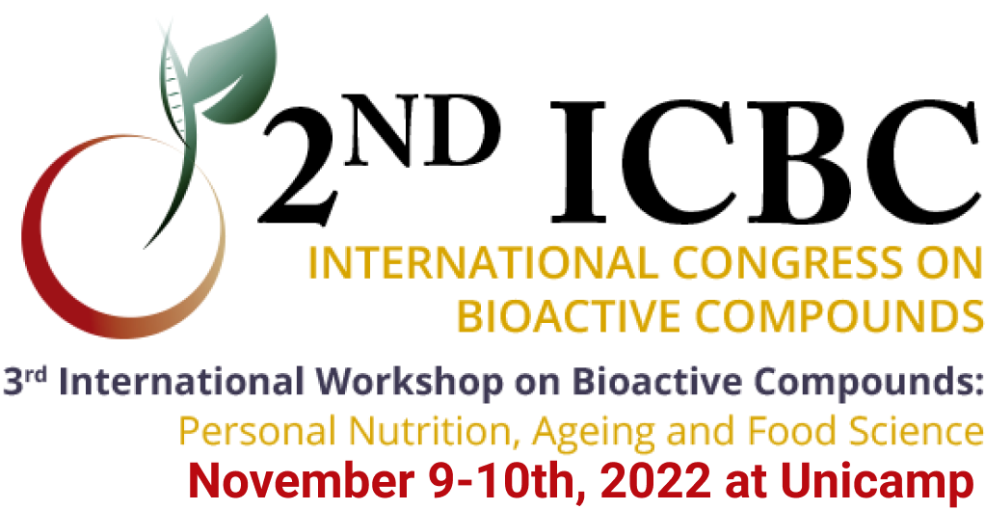
BIOACTIVE PEPTIDES WITH ANTIOXIDANT AND ANTIHYPERTENSIVE PROPERTIES, OBTAINED FROM CHACHAFRUTO SEED FLOUR (ERYTHRINA EDULIS)
Guerra Almonacid Carlos Martín¹; Zapata Montoya José Edgar² ; Acevedo Fernández Juan José ³
cmguerra@ut.edu.co
¹GIRYSOT Research Group, University of Tolima, Colombia. ²Nutrition and Food Technology Research Group, Faculty of Food and Pharmaceutical Sciences, University of Antioquia, Colombia. edgar.zapata@udea.edu.co. ³Faculty of Medicine of the Autonomous University of the State of Morelos. juan.acevedo@uaem.mx.
INTRODUCTIÓN
Hypertension is an important risk factor for atherosclerosis and therefore predisposes to coronary, cerebrovascular and renal diseases, (Mejías C et al., 2004; Torruco-Uco et al., 2009). Food-derived bioactive peptides have great potential for applications such as functional foods and nutraceuticals, for the prevention and treatment of hypertension. Antioxidant tests and in vitro ACE inhibition, as well as in vivo tests, showed that bioactive peptides can be an alternative in the prevention of metabolic diseases such as hypertension. Therefore, it is inferred that chachafruto (Erythrina edulis) could reach be considered as functional and its implementation would generate an impact on food security and also on the prevention of metabolic diseases such as high blood pressure.
a
b
Figure 1. Isolated (a) and sequential (b) enzymatic hydrolysis of chachafruto proteins
Table 1. Protein percentage of chachafruto seed protein isolates
OBJECTIVE
SAMPLE | ABTS mM Trolox/g | DPPH mM Trolox/g
Albumin | 785,14 ± 105,3 | 664,55 ± 99,3
Globulins | 536,19 ± 95,4 | 540,00 ± 88,7
Glutelins | 624,36 ± 98,5 | 576,36 ± 92,5
Evaluate the antioxidant and antihypertensive activity of bioactive peptides obtained from chachafruto seed (Erythrina edulis) by enzymatic hydrolysis.
Obtaining protein concentrate
MATERIALS AND METHODS
Enzymatic hydrolysis
The method described by Adler-Nissen, (1986) with some modifications (Pedroche et al., 2002; and Guerra et al., 2017) was used for the hydrolysis of the protein concentrate, using the enzymes Flavourzyme® (F) and Alcalase® (A), enzyme/substrate (E/S) ratio 5%.
Figure 3. Antihypertensive evaluation of bioactive peptides from chachafruto
In vitro A.A and ACEI tests
ABTS* inhibition activity. The methodology described by Kuskoski et al. (2004) was followed. DPPH* inhibition activity. The methodology described by Braca et al. (2002) was followed with slight modification. The ACE-inhibitory activity was measured by the method of Cushman and Cheung (1971) with slight modifications, as described in a previous publication (Muguerza et al., 2006).
In vivo antihypertensive test
For the in vivo tests, Wistar rats of 9-11 weeks of age were used, weighing between 180-220 g, with groups n=6, Whites, physiological saline 20 mg/kg, negative control (L-Name) 20 mg /kg, Positive Control (Captopril) 5.0 mg/kg and the two concentrations of hydrolysates, low (75 mg/Kg) and high. (150mg/kg).
Figure 4. Isolated (a) and sequential (b) enzymatic hydrolysis of chachafruto proteins
CONCLUSIONS
Sequential hydrolysis improve the degree of hydrolysis and biological activities of hydrolyzates
Chachafruto seed proteins have great antioxidant and antihypertensive potential
The in vivo activity shows that bioactive peptides can be an alternative in the prevention of hypertension
REFERENCES
RESULTS
Megias C, Yust MM, Pedroche J, Lquari H, Girón-Calle J, Alaiz M, Millán F, Vioque J (2004). Purification of an ACE Inhibitory Peptide after Dydrolysis of Sunflower (Helianthus annuus L.) Proetin Isolates. J. Agric. Food Chem. 52:1928-1932.
Torruco-Uco, J., L. Chel-Guerrero, A. Martínez-Ayala, G. Dávila-Ortíz and D. Betancur-Ancona. 2009. Angiotensin-I converting enzyme inhibitory and antioxidant activities of protein hydrolysates from Phaseolus lunatus and Phaseolus vulgaris seeds. J. Food Sci. Technol. 42: 1597-1604.
Pedroche, J., M. M. Yust, J. Girón-Calle, M. Alaiz, F. Millán and J. Vioque. 2002. Utilisation of chickpea protein isolates for production of peptides with angiotensin I-converting enzyme (ACE)-inhibitory activity. J. Sci. Food Agric. 82(9): 960-965
Guerra, A. C. M., W. Murillo and A. J. J. Méndez. 2017. Antioxidant potential use of bioactive peptides derived from mung bean hydrolysates (Vigna Radiata). Afr. J. Food Sci. 11(3): 67-73.
Kuskoski, E. M., A. G. Asuero, M. C. García-Parilla, A. M. Troncoso and R. Fett. 2004. Actividad antioxidante de pigmentos antociánicos. Ciênc. Tecnol. Aliment. 24(4): 691-693.
Braca, A., C. Sortino, M. Politi, I. Morelli and J. Mendez. 2002. Antioxidant activity of flavonoids from Licania licaniaeflora. J. Ethnopharmacol. 79(3): 379-381.
Muguerza, B., M. Ramos, E. Sánchez, M. A. Manso, M. Miguel, A. Aleixandre, M. A. Delgado and I. Recio. 2006. Antihypertensive activity of milk fermented by Enterococcus faecalis strains isolated from raw milk. Int. Dairy J. 16(1): 61-69
Table 1. Protein percentage of chachafruto seed protein isolates
SAMPLE | S1 | S2 | S3 | AVERAGE | SD
Albumin | 88,01 | 86,30 | 90,53 | 88,28 | 2,12
Globulins | 79,96 | 76,85 | 74,46 | 76,76 | 2,25
Glutelins | 93,09 | 92,78 | 90,31 | 92,06 | 1,52
Notes:
Muestra Tamizada

