Slide 1
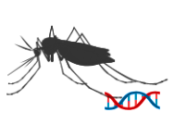

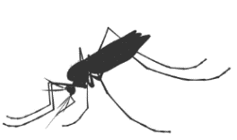
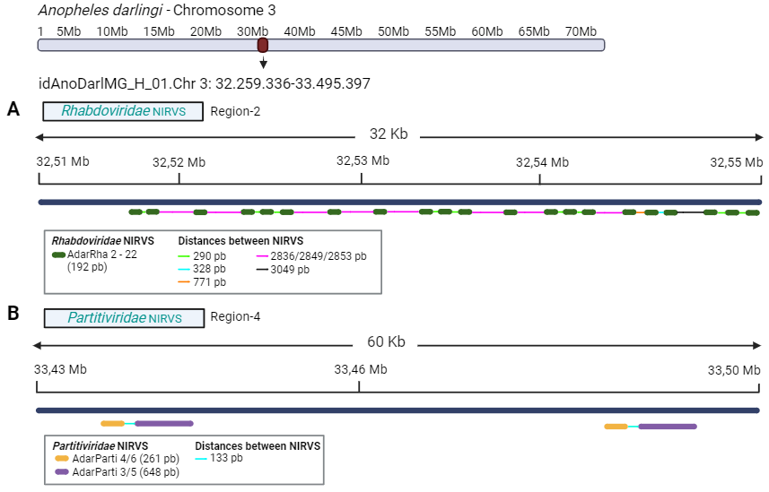
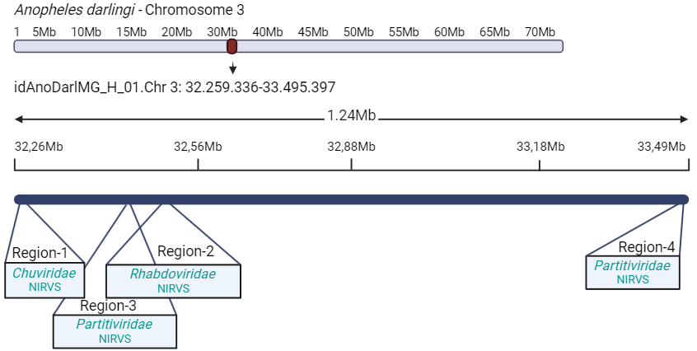

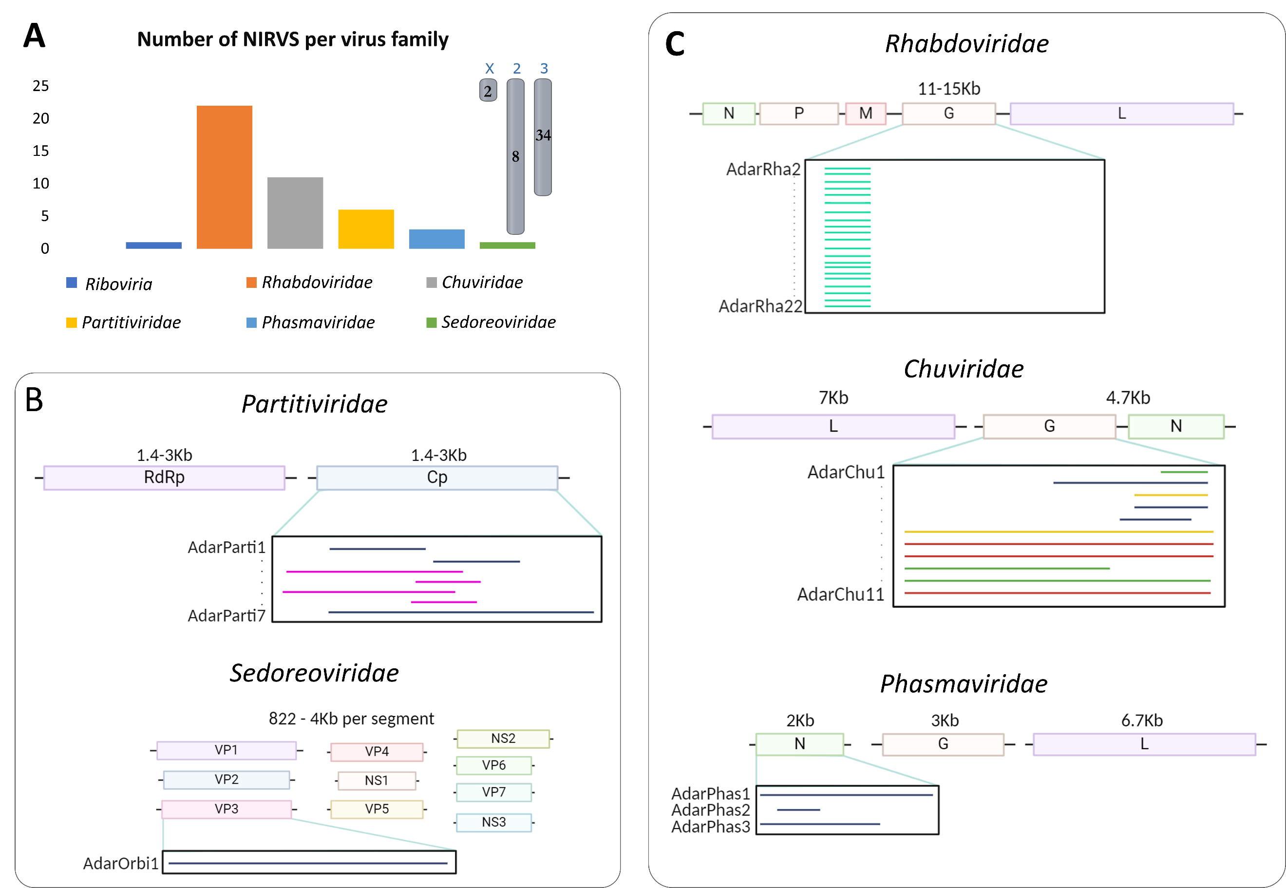
Patterns of endogenous non-retroviral RNA virus and its genomic context in the Anopheles darlingi genome
P0225
Ju an C. Hernández-Valencia¹, Paola Muñoz-Laiton¹, Margarita M. Correa¹
¹Grupo Microbiología Molecular, Escuela de Microbiología, Universidad de Antioquia, Medellín, Colombia
INTRODUCTION
Most NIRVS were detected in proximity regions of Chr3, within 1.24 Mb; four regions were located between positions 32.26 Mb and 33.49 Mb, here designated as regions 1-4 (Fig. 2A). These NIRVS and their lengths were, region-1: four; region-2: 21; region-3: two and region-4: four NIRVS. In region-2, 21 NIRVS derived from Rhabdoviridae family were clustered, all representing repetitions of the same sequence with the same length. In region-4, four NIRVS derived from the Partitiviridae family were found in a similar pattern (Fig. 2B).
The genomic context of the NIRVS showed enrichment of retrotransposon sequences, corresponding to LTR elements of the BEL/Pao and Ty3/Gypsy LTR families.
The sequencing of new genomes and the discovery of new viral sequences has raised exponentially and potentiated the discovery of endogenous viral elements of non-retroviral integrated RNA viral sequences (NIRVS) in the genome of diverse hosts (1). Despite their relevance, most studies on NIRVS have primarily focused on Aedes albopictus and Aedes aegypti (2). Few investigations have evaluated NIRVS in the genomes of Anopheles species (3).
This work aimed to characterize NIRVS, their integration patterns and genomic context in the reference genome of Anopheles darlingi, an important neotropical malaria vector.
MATERIALS AND METHODS​
NIRVS identification within the An. darlingi reference genome
1) Identification of NIRVS
2) Characterization of genomic context
tBLASTn
The complete An. darlingi genome was aligned against reference viruses
BLAST 2 Sequences mode of the BLAST tool
An. darlingi reference genome (idAnoDarlMG_H_01) 2022
NCBI Virus repository
Identification of Open Reading Frames in the An. darlingi genome
- 10 Kb /+10 Kb of NIRVS flanking regions Genious Prime
Viral sequences identified were verified in a second BLASTx search against the non-redundant NCBI database
Prediction of protein domains in NIRVS
HHpred tool
Those with identity >98% were considered duplicates and only one was considered
Clustal Omega
Presence of transposable elements (TEs) in integration sites
RepeatMasker
RESULTS
Figure 2. A. Chromosome 3 loci in the An. darlingi reference genome where most of the identified NIRVS were clustered. B. NIRVS clusters display a repeat pattern in An. darlingi chromosome 3: NIRVS derived from Rhabdoviridae in region-2 and NIRVS derived from Partitiviridae in region-4.
A total of 44 NIRVS were identified in the An. darlingi reference genome. These NIRVS corresponded to integrations of negative single-stranded RNA viruses (ssRNA-) from the families Rhabdoviridae (n=22), Chuviridae (n=11) and Phasmaviridae (n=3), as well as integrations of double-stranded RNA viruses (dsRNA) from the families Partitiviridae (n=6) and Sedoreoviridae (n=1). In addition, one NIRVS aligned to a viral sequence classified at the Riboviria domain (n=1) (Fig. 1).
CONCLUSIONS
This is the first characterization of NIRVS in the An. darlingi genome.
Results demonstrate that NIRVS in An. darlingi are clustered in specific genome regions, enriched with LTR retrotransposons, which are characteristic of piRNA clusters (4) that have a role in the regulation of exogenous viruses in mosquitoes (5).
These findings indicate that NIRVS are a complex component of the An. darlingi genome which require further investigation aimed to understand viral regulation mechanisms in the Anopheles genus.
AcknowledgmentS
This work received support from Escuela de Microbiología, Universidad de Antioquia, project codes No. 2021-41851, 2023-66350, ESCIEM-02-2024.
We thank the field technicians and the Entomology Unit of the Guaviare Health Secretariat for their support in collecting the specimens.
REFERENCES
Houé, V., Bonizzoni, M., & Failloux, A.. (2019). Endogenous non-retroviral elements in genomes of Aedes mosquitoes and vector competence. Emerg. microbes & infect., 8(1), 542–555. https://doi.org/10.1080/22221751.2019.1599302.
Gilbert, C., & Belliardo, C. (2022). The diversity of endogenous viral elements in insects. CRIS, 49, 48–55. https://doi.org/10.1016/j.cois.2021.11.007.
Palatini, U., Contreras, C. A., Gasmi, L., & Bonizzoni, M. (2022). Endogenous viral elements in mosquito genomes: current knowledge and outstanding questions. CRIS, 49, 22–30. https://doi.org/https://doi.org/10.1016/j.cois.2021.10.007.
Santos, D., Feng, M., Kolliopoulou, A., Taning, C. N. T., Sun, J., & Swevers, L. (2023). What Are the functional roles of Piwi proteins and piRNAs in insects?. Insects (Vol. 14, Issue 2). https://doi.org/10.3390/insects14020187.​
Suzuki, Y., Baidaliuk, A., Miesen, P., Frangeul, L., Crist, A., Merkling, S., Fontaine, A., Lequime, S., Moltini-Conclois, I., Blanc, H., van Rij, R., Lambrechts, L., & Saleh, M. (2020). Non-retroviral endogenous viral element limits cognate virus replication in Aedes aegypti ovaries. Curr. Biol.: CB, 30(18), 3495-3506.e6. https://doi.org/10.1016/j.cub.2020.06.057.
Figure 1. NIRVS detected in the An. darlingi reference genome. A. Number of NIRVS identified per virus family. B. and C. Position of each identified NIRVS relative to the genome sequence of a representative virus with double-stranded RNA and negative single-stranded RNA genomes, respectively.

