Slide 1

Diamond 2 Action
Addressing the Global Landscape of
Type 1 Diabetes
Paula A. Diaz V. MD, MPH, PhD
University of Antioquia
Colombia
On behalf of the Diamond 2 Action Collaboration

Slide 2

This presentation is dedicated with consideration and respect to children, adults, families and communities who have the experience of living with Diabetes.
And to all those who believe that a world with less suffering due to diabetes is possible, together we can!
No conflict of interest is declared.
Esta foto de Autor desconocido está bajo licencia CC BY-SA-NC

Slide 3
Content
Diamond 2 Action Collaboration
Global incidence of type 1 Diabetes
Moving the agenda forward for type 1 Diabetes
Actions
Joining the Diamond 2 Action Collaboration network!!
Background – The global picture

Slide 4
Background – the global picture
Diamond 2 Action Collaboration
Specificities of type 1 diabetes
Common chronic disease
Most frequently diagnosed in children and adolescents
Most frequently occurring in adults
Need for insulin to ensure survival
In parallel to need for support in general from health system and social system
Increase in burden in low- and middle-income countries
Health system capacity to respond

Slide 5
Background – the global picture
Diamond 2 Action Collaboration
Global agenda
Centenary of insulin’s discovery (2021) and its first use (2022)
Diabetes one of the five prioritized Noncommunicable Diseases
Most of the focus on type 2 diabetes
Global Diabetes Compact
World Health Assembly Resolution
Global targets
“100% of people with type 1 diabetes have access to affordable insulin treatment and blood glucose self-monitoring”
Lancet Diabetes and Endocrinology Commission on type 1 diabetes
D. Beran, K. Ramaiya and J. Zafra-Tanaka co-leads

Slide 6

The Discovery and Early Development of Insulin
Banting’s original idea - 31 October 1920
“Diabetus – Ligate pancreatic ducts of dog – Keep dogs alive till acini degenerate leaving Islets – Try to insolate the internal secretion of these to relieve glycosuria”
Diamond 2 Action Collaboration
  Source: https://definingmomentscanada.ca/insulin100/timeline/
Notes:
31 October 1920 – Banting’s original idea
In the early hours of October 31, 1920, in London, Ontario, 28-year-old Dr. Frederick G. Banting woke up suddenly. He had had a flash of insight for a novel experiment to isolate the elusive internal secretion of the pancreas as a means of treating diabetes.
Banting, had been reading about carbohydrate metabolism and diabetes. After a few hours of disturbed sleep, he awoke with a compelling idea that he quickly jotted down in a notebook.

Slide 7
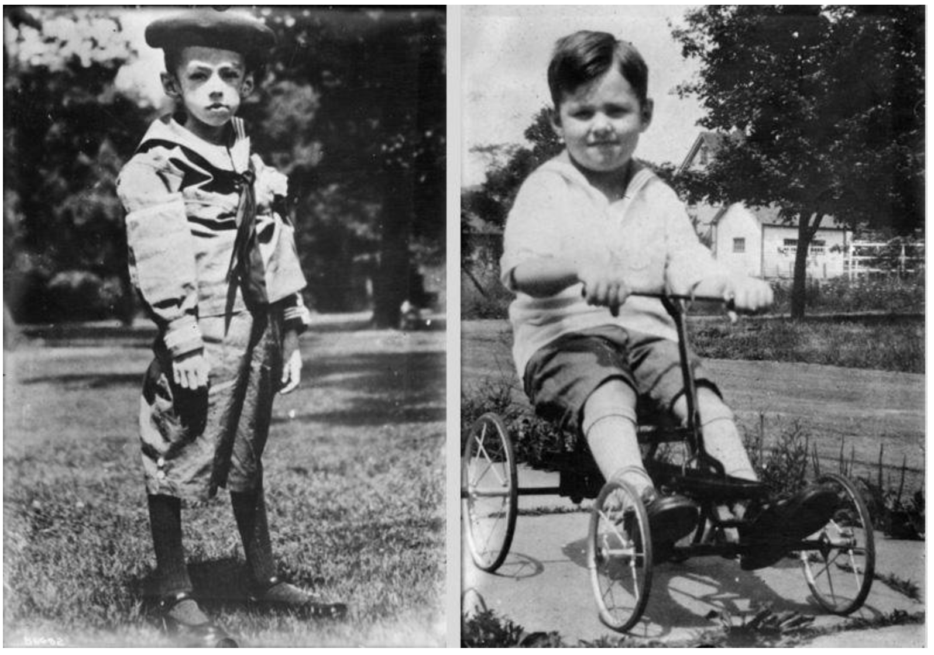
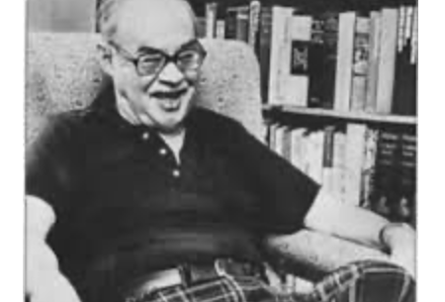
Diabetic patient successfully treated since 1922
Teddy Ryder, before and after insulin treatment and, in his 70s.
Diamond 2 Action Collaboration
  Banting House National Historic Site.
  Source: https://definingmomentscanada.ca/insulin100/timeline/
Notes:
By February 1922, six more diabetic patients at TGH has been successfully treated with the extract, along with Dr. Gilchrist. Throughout the Spring, more patients would be treated with insulin. Read about some of them here.
Teddy Ryder in his 70s. The Long Life of One of Banting’s First Patients, The Banting House Museum.
“I shall always follow your career with interest and, you will forgive me if I add, a little pride, because I shall always remember the difficult times we had in the early days of insulin. The outstanding thing I remember was your strength and fortitude in observing your diet and the manly way in which you stood up to the punishment of hypodermic injections. I am sure that you will be a success in life if you maintain the same spirit in meeting the rebuffs of the world.” (Dec. 27, 1938)

Slide 8
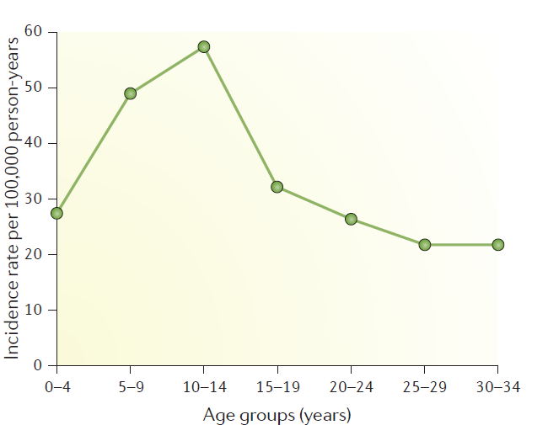

T1D according to age presentation
Katsarou et al. Type 1 diabetes mellitus. NATURE REVIEWS, 2017
Diamond 2 Action Collaboration

Slide 9
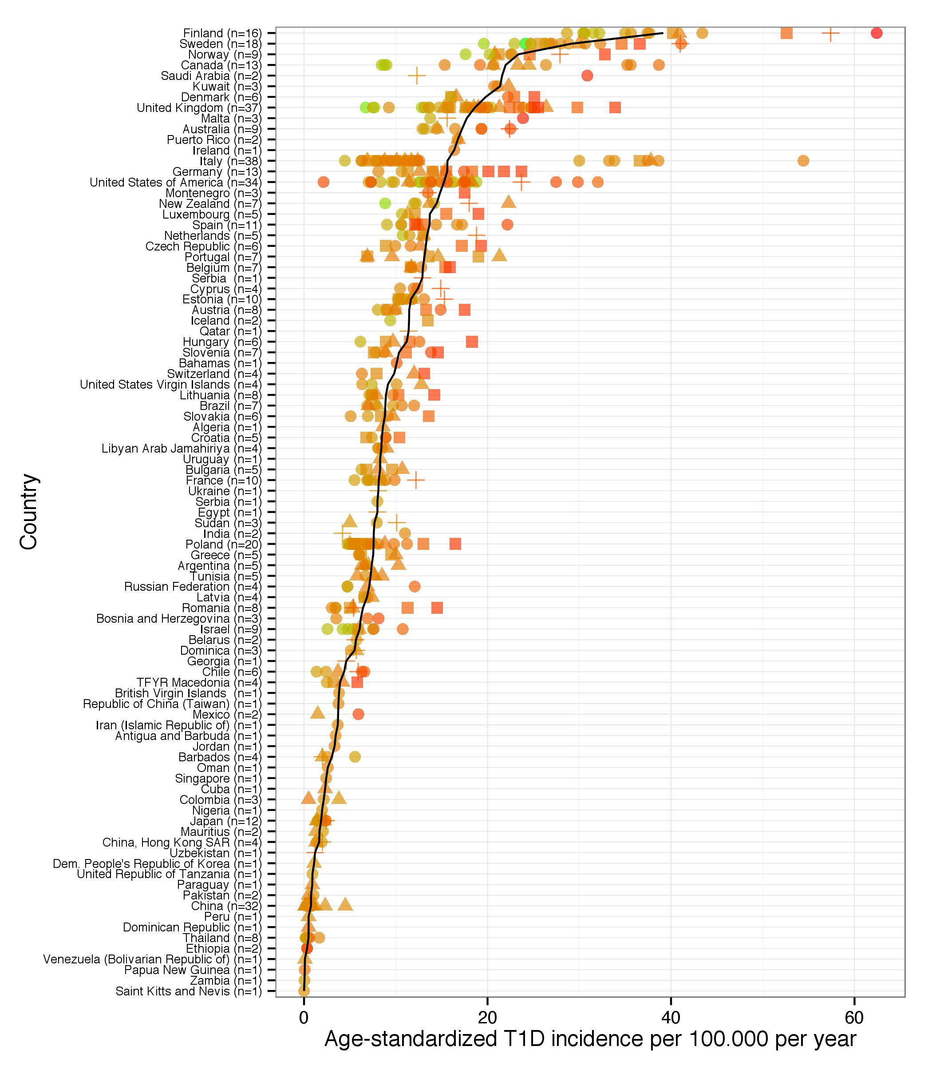
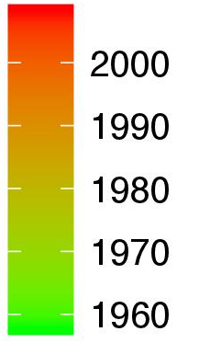
T1D incidence studies published between 1958 to 2009
n = 298
Triangles: Diamond 114 studies
Squares: 87 Eurodiab
Plus: 28 IDF
Diamond 2 Action Collaboration
Incidence of T1D per 100.000 per year in both sexes (0-14 years)
P Diaz, 2015
Notes:
Incidence of T1D per 100.000 per year in both sexes (0-14 years)
N = 298

Slide 10
Incidence is increasing in many countries!
Diamond 2 Action Collaboration
Slide courtesy Dr. G.Ogle
Toumilehto J, Ogle GD, Lund-Blix N, Stene LC. Epidemiology of childhood type 1 diabetes. Pediatr Endocrinol Rev 2020;17(Suppl 1):198-209.

Slide 11
T1D Publications between
1980-2015
Diamond 2 Action Collaboration
P. Diaz, 2015
Notes:
# Publications par région du monde

Slide 12
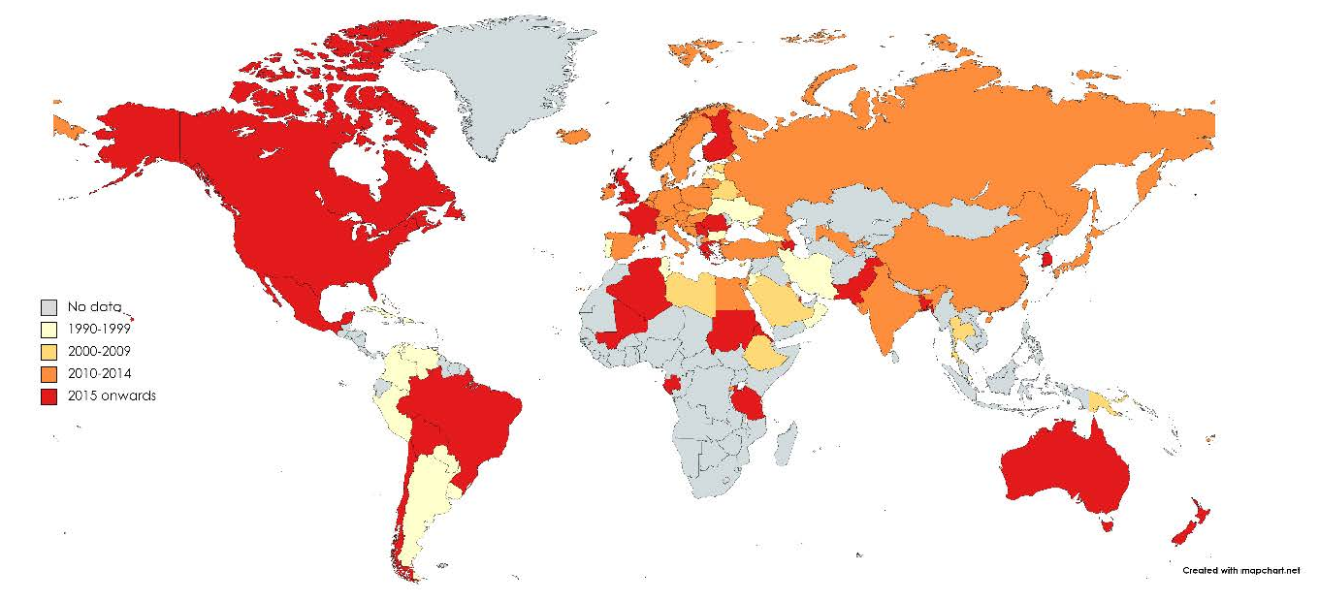
Year of publication of T1D incidence studies until 2021
Diamond 2 Action Collaboration
Ogle, James, Dabelea, Pihoker, Svensson, Maniam, Klatman, Patterson, Diabet Res Clin Pract 2021
Slide courtesy of Dr. G.Ogle

Slide 13
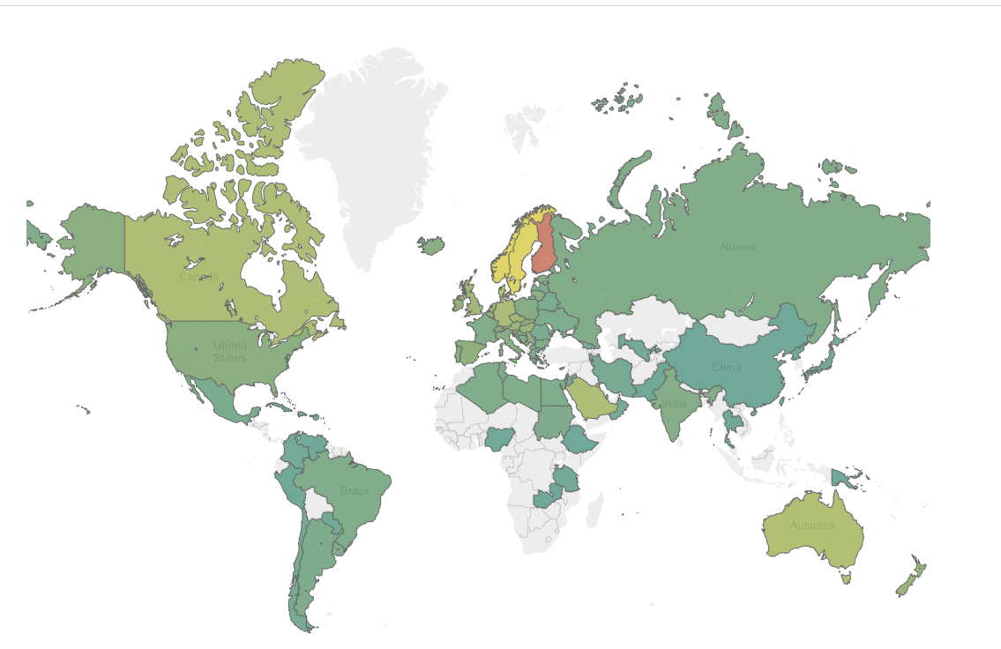
Geographical distribution of countries where T1D incidence has been reported in the literature 1975-2014
Diamond 2 Action Collaboration
Mean T1D incidence per 100.000 individuals aged 0-14 years per year is in color gradient.
P. Diaz, 2015

Slide 14
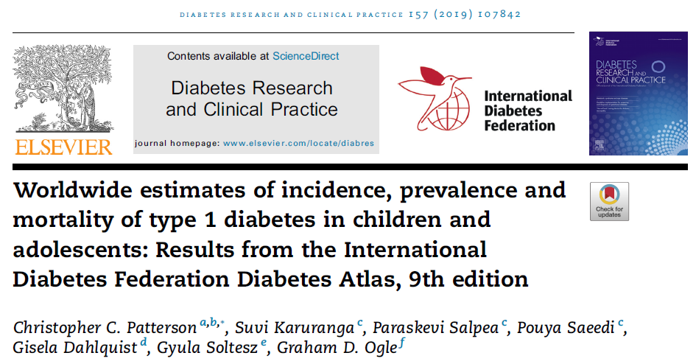
Diamond 2 Action Collaboration
Christopher C. Patterson et al. Worldwide estimates of incidence, prevalence and mortality of type 1 diabetes in children and adolescents: Results from the International Diabetes Federation Diabetes Atlas, 9th edition., 2019

Slide 15
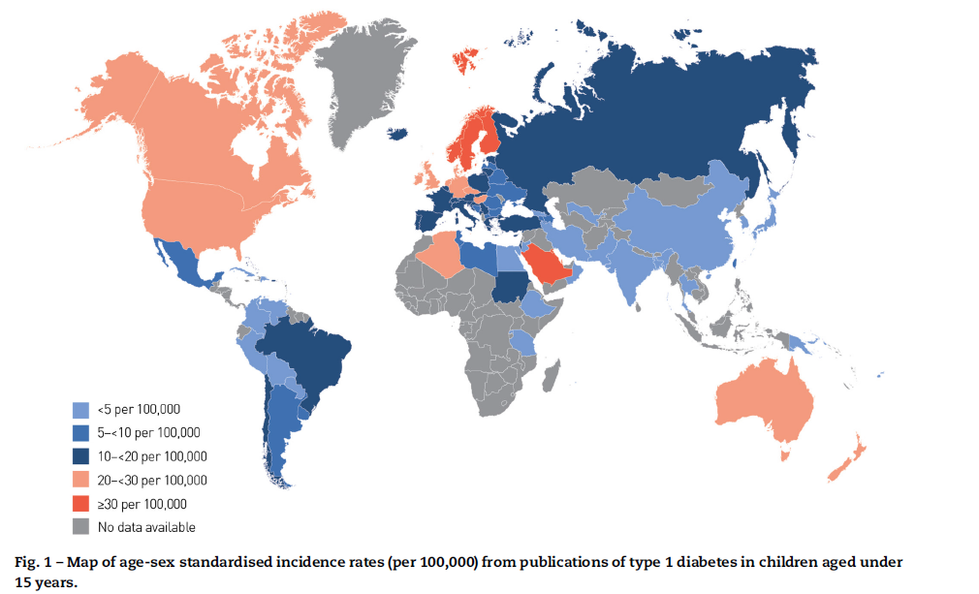
Distribution of type 1 diabetes
Diamond 2 Action Collaboration
Christopher C. Patterson et al. Worldwide estimates of incidence, prevalence and mortality of type 1 diabetes in children and adolescents: Results from the International Diabetes Federation Diabetes Atlas, 9th edition. 2019
Notes:
Los datos con los cuales se estiman las prevalencias en el 2021 proceden de datos de publicaciones realizadas en la década de 1990.

Slide 16
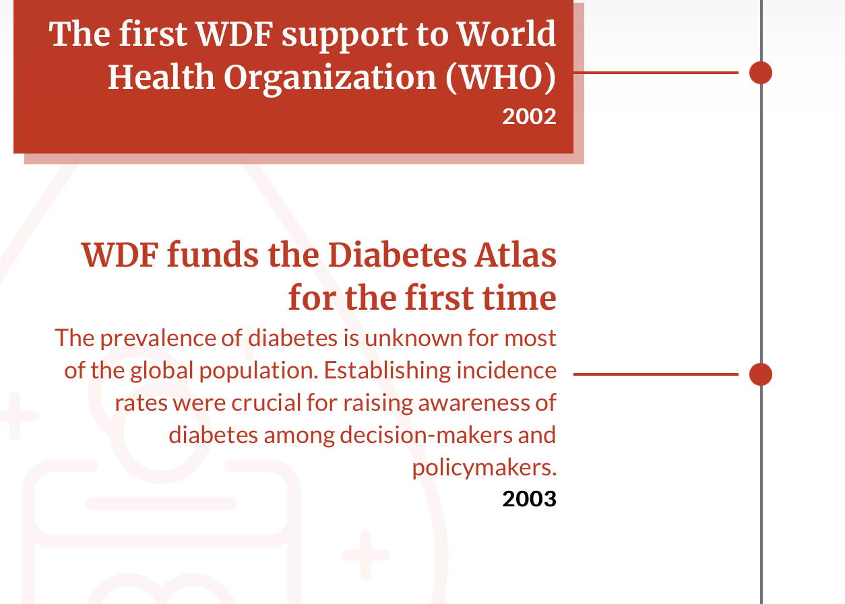
Diamond 2 Action Collaboration
… and >20 years later….
! The Prevalence of diabetes is unknown for most of the global population !
Fuente: https://worlddiabetesfoundation.org/what-we-do/wdf-s-impact-journey/
Notes:
¡La prevalencia de diabetes es desconocida para la mayoría de la población global!
¡Conocer las tasas de incidencia es crucial para la toma de decisiones en salud!

Slide 17
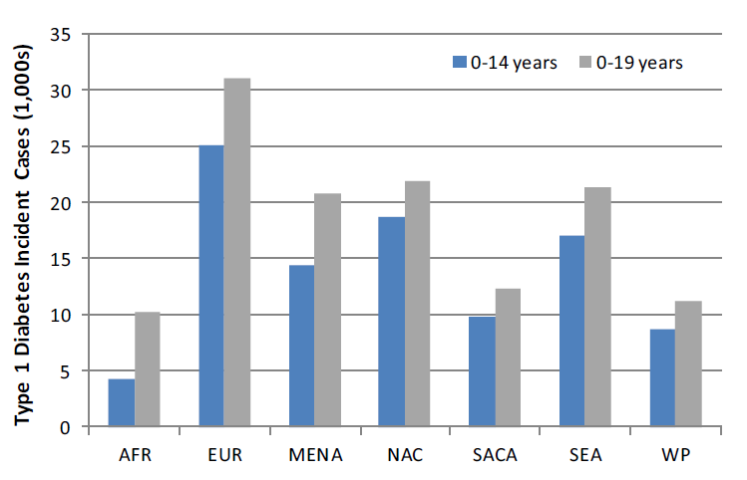
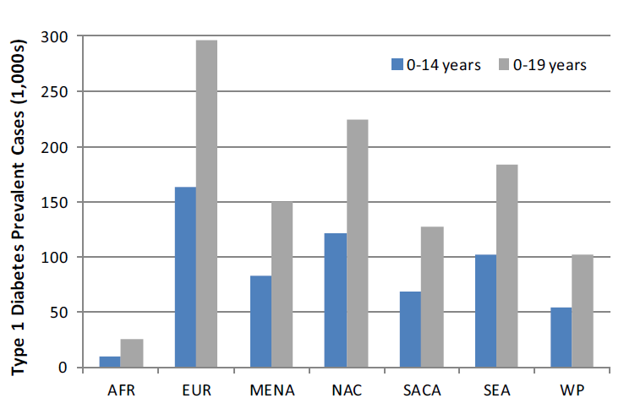
T1D epidemiology
Distribution of the world incidence and Prevalence cases by region
Diamond 2 Action Collaboration
Tomado de: Christopher C. Patterson et al. Worldwide estimates of incidence, prevalence and mortality of type 1 diabetes in children and adolescents: Results from the International Diabetes Federation Diabetes Atlas, 9th edition.

Slide 18
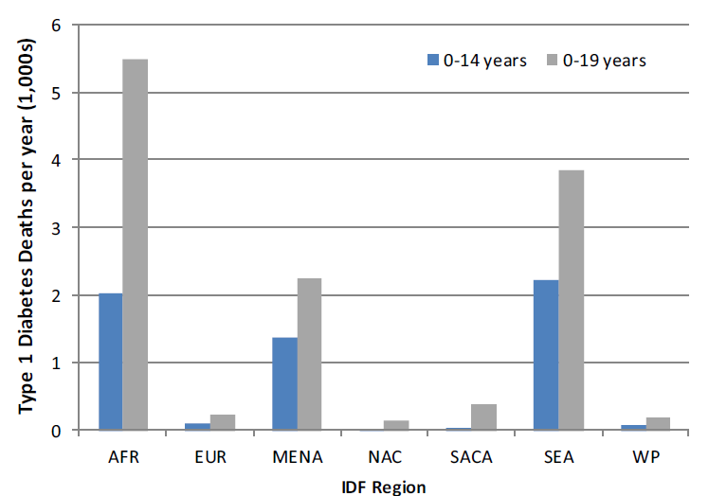
T1D epidemiology
Distribution of the world deaths per year by region
Diamond 2 Action Collaboration
Tomado de: Christopher C. Patterson et al. Worldwide estimates of incidence, prevalence and mortality of type 1 diabetes in children and adolescents: Results from the International Diabetes Federation Diabetes Atlas, 9th edition.
Notes:
África
Europa
Región de Medio Oriente y África del Norte
Región de América del Norte y el Caribe
Región de América del Sur y Central
Región de Asia Sudoriental
SEA _ South East Asia

Slide 19
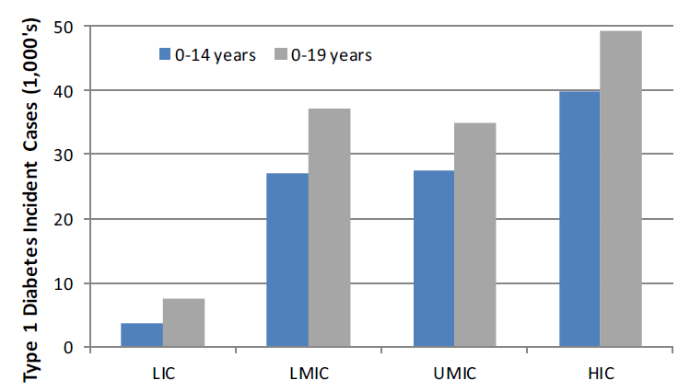
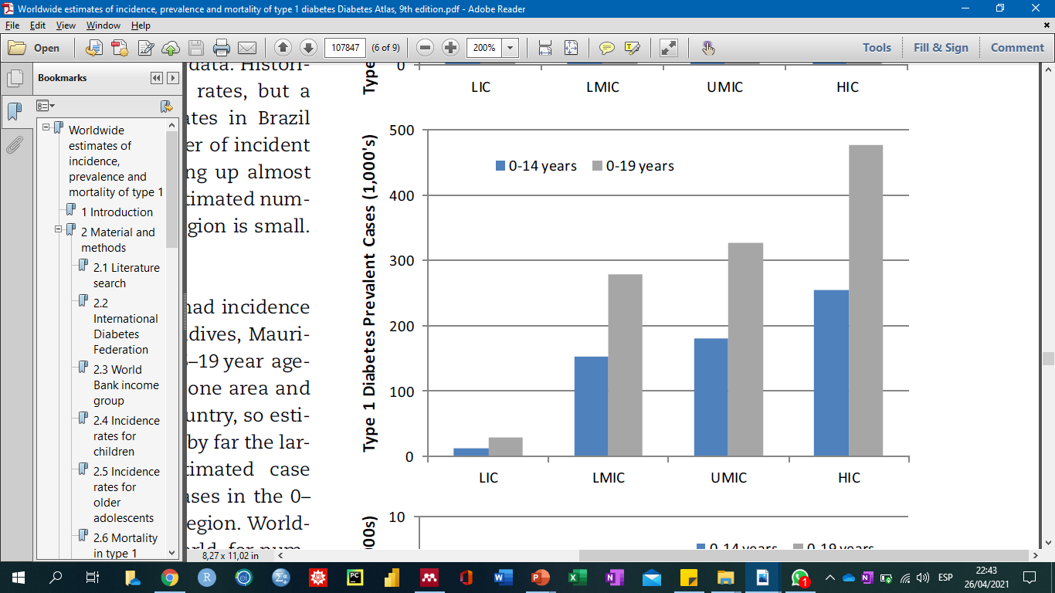
T1D epidemiology
Distribution of the world incidence and Prevalence cases by income
Diamond 2 Action Collaboration
Tomado de: Christopher C. Patterson et al. Worldwide estimates of incidence, prevalence and mortality of type 1 diabetes in children and adolescents: Results from the International Diabetes Federation Diabetes Atlas, 9th edition.

Slide 20
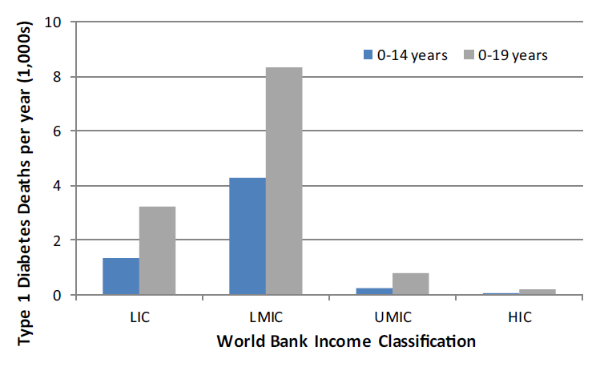
T1D epidemiology
Distribution of the world deaths per year by income
Diamond 2 Action Collaboration
Tomado de: Christopher C. Patterson et al. Worldwide estimates of incidence, prevalence and mortality of type 1 diabetes in children and adolescents: Results from the International Diabetes Federation Diabetes Atlas, 9th edition.

Slide 21
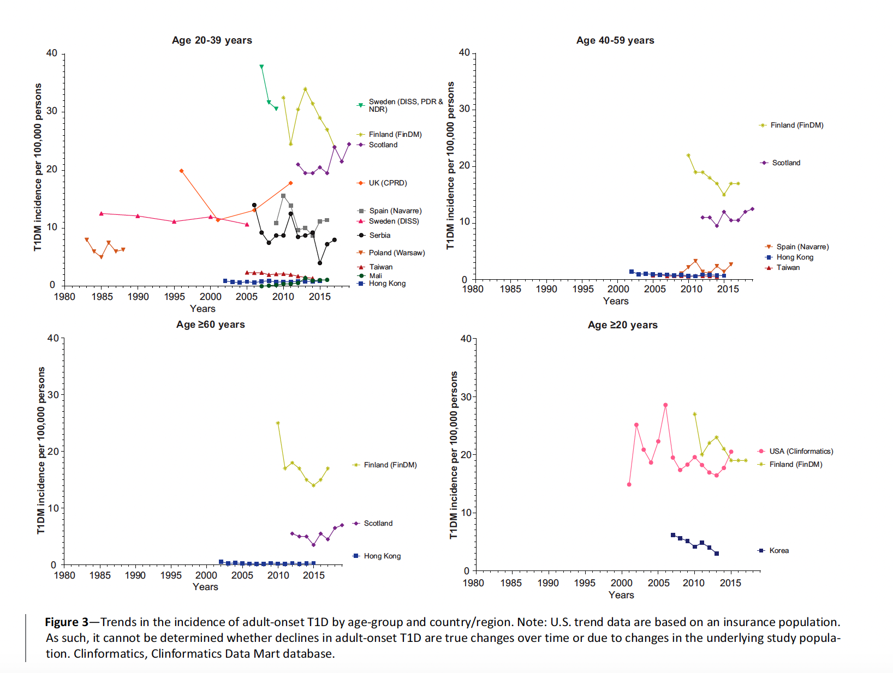
T1D in adults
Harding J. Incidence of Adult-Onset T1D From 32 Regions Diabetes Care Volume 45, April 2022
Diamond 2 Action Collaboration
Notes:
Harding J. Incidence of Adult-Onset T1D From 32 Regions Diabetes Care Volume 45, April 2022

Slide 22
T1D incidence in adults*
Diamond 2 Action Collaboration
*Studies reporting specific anti B cells proteins or C Peptide detection (14 of 70 papers between 1982 to 2014)
P Diaz. et al. BMC Public Health, 2015
Notes:
# Age variation_graphic 14 studies with AA
Sophie Valtat Map
https://public.tableau.com/profile/sophiev#!/vizhome/IncidenceT1DAdults/Feuille1#modal-signin

Slide 23
Diamond 2 Action Collaboration
P Diaz. et al. BMC Public Health, 2015

Slide 24

8.7 million people worldwide are living with Type 1 Diabetes in 2022
Of these,
1.5 million are less than 20 years old
Diamond 2 Action Collaboration
Slide courtesy Dr. G.Ogle

Slide 25

Moving the agenda for Type 1 Diabetes forward
Diamond 2 Action Collaboration
Believing in utopias

Slide 26
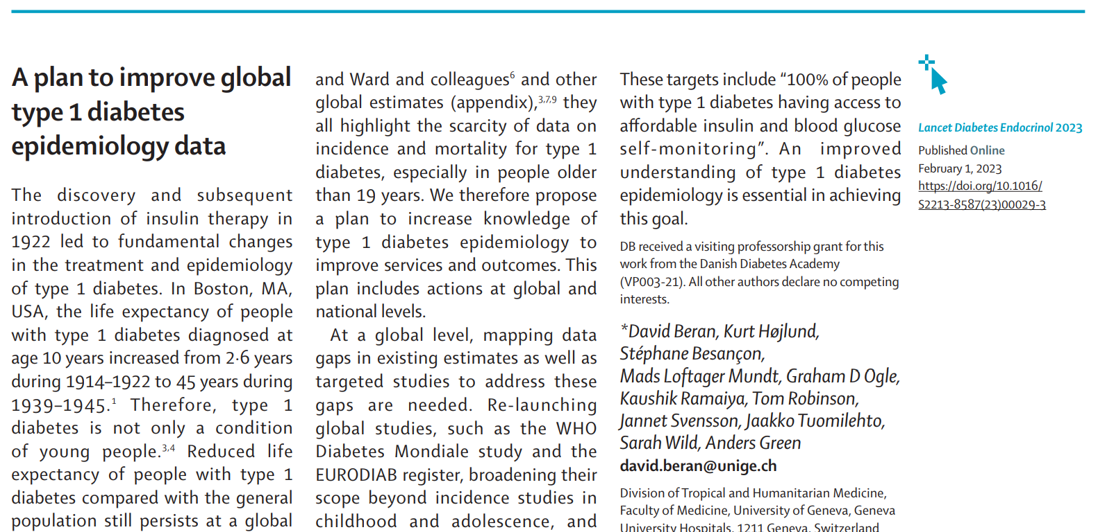
Background – Moving the agenda forward
Diamond 2 Action Collaboration

Slide 27






Development of a core group of experts
Presentation and discussion in Dar es Salaam during East African Diabetes Study Group Meeting
Meeting in Geneva in November 2023
15 experts from 11 countries
Meeting supported by the Swiss Agency for Development and Cooperation as part of the NCD Policy Lab hosted at the University of Geneva
Development of concept
Re-launch of DIAMOND study as DIAMOND 2 Action
Diamond 2 Action Collaboration
Based on Correspondence in the Lancet Diabetes and Endocrinology

Slide 28
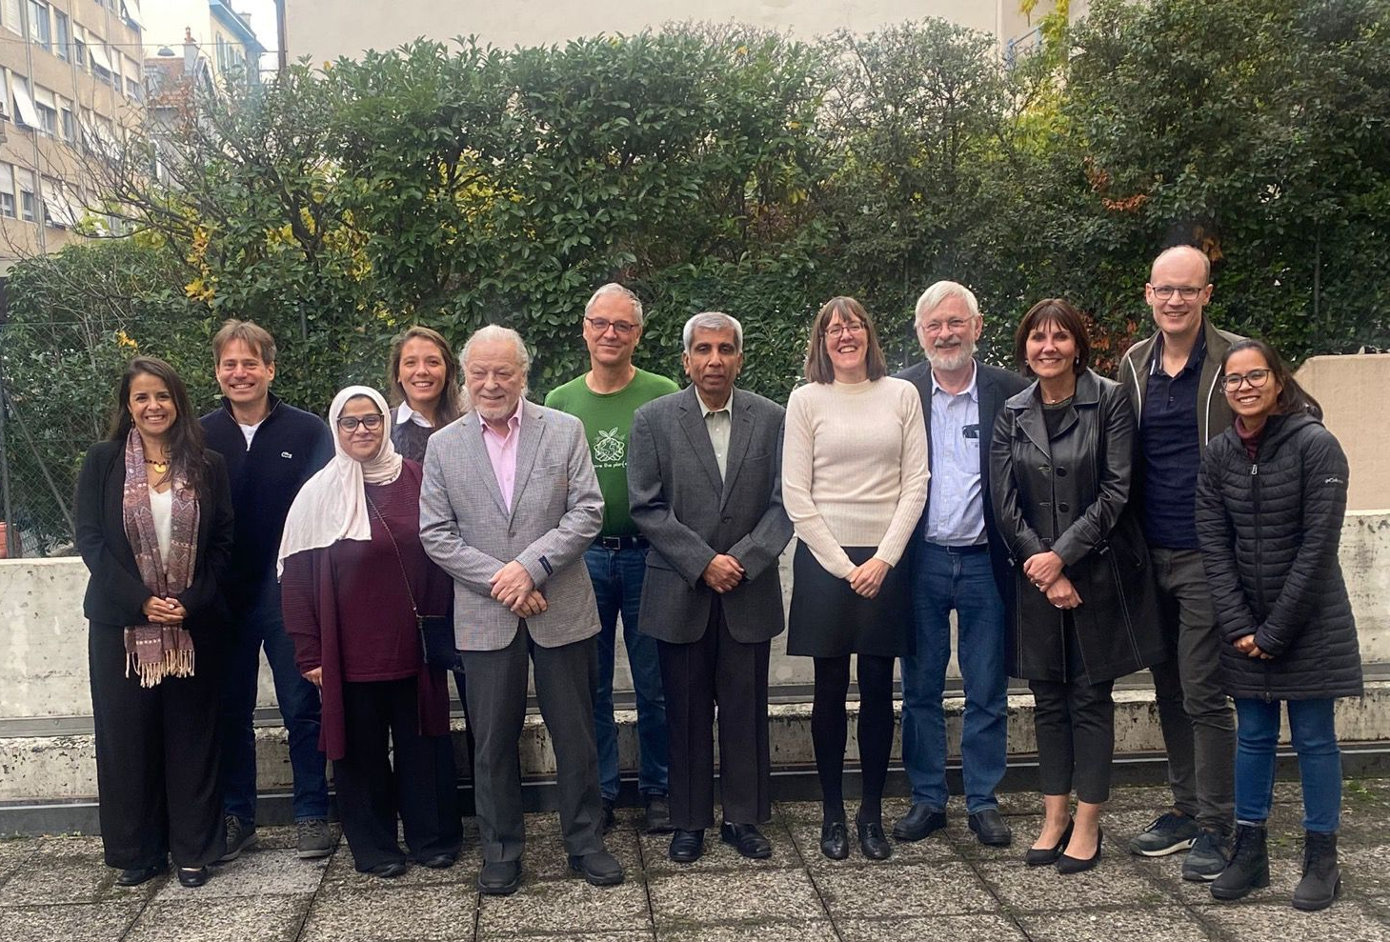



First expert meeting
Geneva, Nov. 2023
Diamond 2 Action Collaboration
Left to right: Paula Diaz (Colombia), David Beran (Switzerland), Marina.Giachino (Switzerland), Hessa Alkandari (Kuwait), Jaakko Tuomilehto (Finland), Thomas Waldhör (Austria), Kaushik Ramaiya (Tanzania), Sarah Wild (UK), Anders Green (Denmark), Dana M Dabelea (US), Morten Bjerregaard-Andersen (Denmark), Jessica Zafra (Perú), A. Ramachandran (India), Graham Ogle (Australia), Gojka Roglic (Switzerland)
Notes:
Left to right: Paula Diaz (Colombia)
David Beran (Switzerland)
Marina.Giachino (Switzerland)
Hessa Alkandari (Kuwait)
Jaakko Tuomilehto (Finland)
Thomas Waldhör (Austria)
Kaushik Ramaiya (Tanzania)
Sarah Wild (UK)
Anders Green (Denmark)
Dana M Dabelea (US)
Morten Bjerregaard-Andersen (Denmark)
Jessica Zafra (Perú)
A. Ramachandran (India)
Graham Ogle (Australia)
Gojka Roglic (Switzerland)

Slide 29

Collaborators around the world
Diamond 2 Action Collaboration

Slide 30

Diamond 2 Action Collaboration

Slide 31
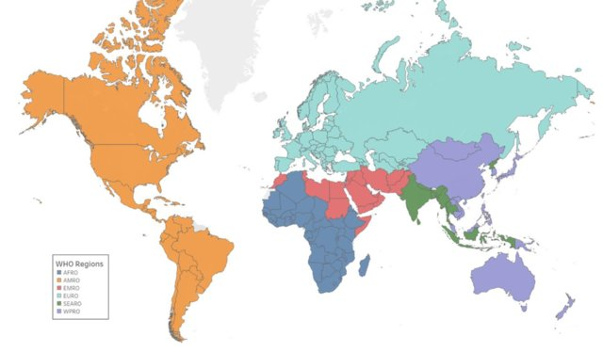
1. Regional Webinars – DIAMOND 2 Action
Diamond 2 Action Collaboration
Presentations in different languages
Aim of the Webinars
To inform about DIAMOND 2 Action
To directly involve other participants/Researchers
To learn and integrate other initiatives
To create a larger Network
Notes:
AFRO
EMRO
EURO
PAHO
SEARO
WIPRO
Other
Lusophone
China

Slide 32
2. Dissemination – DIAMOND 2 Action
Diamond 2 Action Collaboration
Grants
UK MRC - MRC Applied Global Health Research Board
Global Science Summit Programme
Novo Nordisk Foundation - Denmark
Conferences
11 WCPD, Mumbai 2024
Sessions submitted
IDF 2025
EASD 2024
AMNET, Perú 2024
Notes:
Novo Nordisk Foundation - Enhancing Type 1 Diabetes Care in Latin America through an Open Source Data Infrastructure. The LatinDiab-1 Project
MRC Applied Global Health Research Board - Improving care and outcomes of diabetes among children and young adults in low and middle-income countries: the DIAMOND-2 collaboration

Slide 33
DIAMOND 2 Action – Goals
Diamond 2 Action Collaboration
To promote research
To support development/ maintenance
To strengthen capacity and the development of guidelines,
To advance advocacy
To advance empowerment
of sustainable cost-effective health systems including access to essential supplies (particularly insulin and glucose monitoring tools) to improve outcomes for people with type 1 diabetes
especially in young researchers, in epidemiology and public health research skills linked with type 1 diabetes
on type 1 diabetes in dialogue with governments, healthcare providers and other stakeholders incl. patient organization
for persons with type 1 diabetes
in type 1 diabetes including, but not exclusively, epidemiology, health system research, health economic and outcome research, and health technology assessments

Slide 34
DIAMOND 2 Action – Objectives
Diamond 2 Action Collaboration
To create partnerships that, based on collaborative network activities, will:
Promote epidemiological, public health, health utilization and health economics research in type 1 diabetes.
Support capacity-building for epidemiological, public health and multi-disciplinary health services research.
Provide relevant information for communication with decision-makers to support prioritization and policymaking concerning the diagnosis, monitoring, and management of type 1 diabetes globally and locally.
Supply key epidemiological and healthcare data for patient organizations and people with type 1 diabetes.

Slide 35
DIAMOND 2 Action – Components
Diamond 2 Action Collaboration
Data and Research
Studies
Registers
Capacity Development
Support
Networks
Study visits
South-South / North-North / North-South / South-North sharing of experiences
Twinning
For policy makers
Communication/Advocacy for improving diabetes care
Reports
National
Global
Publications and other scientific outputs
Stakeholder engagement
How data is presented
Epidemiology and Research
Capacity Development
Communication and Advocacy

Slide 36
DIAMOND 2 Action – Data and Research
Diamond 2 Action Collaboration

Slide 37
DIAMOND 2 Action – Data and Research
Diamond 2 Action Collaboration
Data quality and standards:
Data security and preservation:
Compliance with regulations:
Transparency:
Data ownership and intellectual property rights:
Ethical considerations:
Data accessibility:
Developing tools to ensure data quality standards for accurate, reliable, and consistent data
Measures to guarantee data security at all levels of the data collection, aggregation and use processes as well as back-up systems
Adherence to relevant data protection laws and regulations to ensure privacy and security
Ownership remains with the country where data is collected.
About data sharing processes, including how data is collected, analyzed, shared and used in publications.
Ethical principles in data collection, use and reporting including: obtaining informed consent from participants and protecting vulnerable populations; and ensuring co-authorship and appropriate acknowledgements
Ensuring that data is easily accessible to other researchers for reuse, replication, and validation of research findings.
Principles of DIAMOND 2A with regards to data:

Slide 38
DIAMOND 2 Action – Capacity Development
Diamond 2 Action Collaboration
Research Support
Research training and supervision
Clearing House Activities
Guidelines

Slide 39
DIAMOND 2 Action – Communication and Advocacy
Communication and Advocacy
Making relevant information available for communication with decision-makers to support prioritization and policymaking concerning the diagnosis, monitoring and management of type 1 diabetes
Empowerment
Supply key epidemiological and healthcare data for patient organizations and people with type 1 diabetes
Diamond 2 Action Collaboration

Slide 40
DIAMOND 2 Action – An opportunity for collaboration
Aligned with multiple global initiatives
Builds off previous experience of global studies
Complementary expertise and networks
Builds off existing strengths of each partner
Showcases Danish excellence in diabetes
Joint initiatives
Diamond 2 Action Collaboration

Slide 41
DIAMOND 2 Action – Joining the network?
Are you interested in joining the DIAMOND 2 Action Collaboration?
Or simply following-up closely what is being achieved?
Click on the Link & fill-in the survey: https://forms.gle/uZASzmQYQg2CPTPW8
Diamond 2 Action Collaboration

Slide 42

What is utopia for?
Diamond 2 Action Collaboration
She is on the horizon.
I take two steps closer, she takes two more steps away.
I walk ten steps and the horizon moves ten steps further.
No matter how much I walk, I will never reach it.
What is utopia for?
That's what it's for: walking.
Eduardo Galeano, poet, Uruguay

Slide 43

Thank you for your attention!
Any comment or question please contact me at: paula.diaz@udea.edu.co
LinkedIn: Paula Andrea Diaz Valencia
Diamond 2 Action Collaboration

